Slide 1
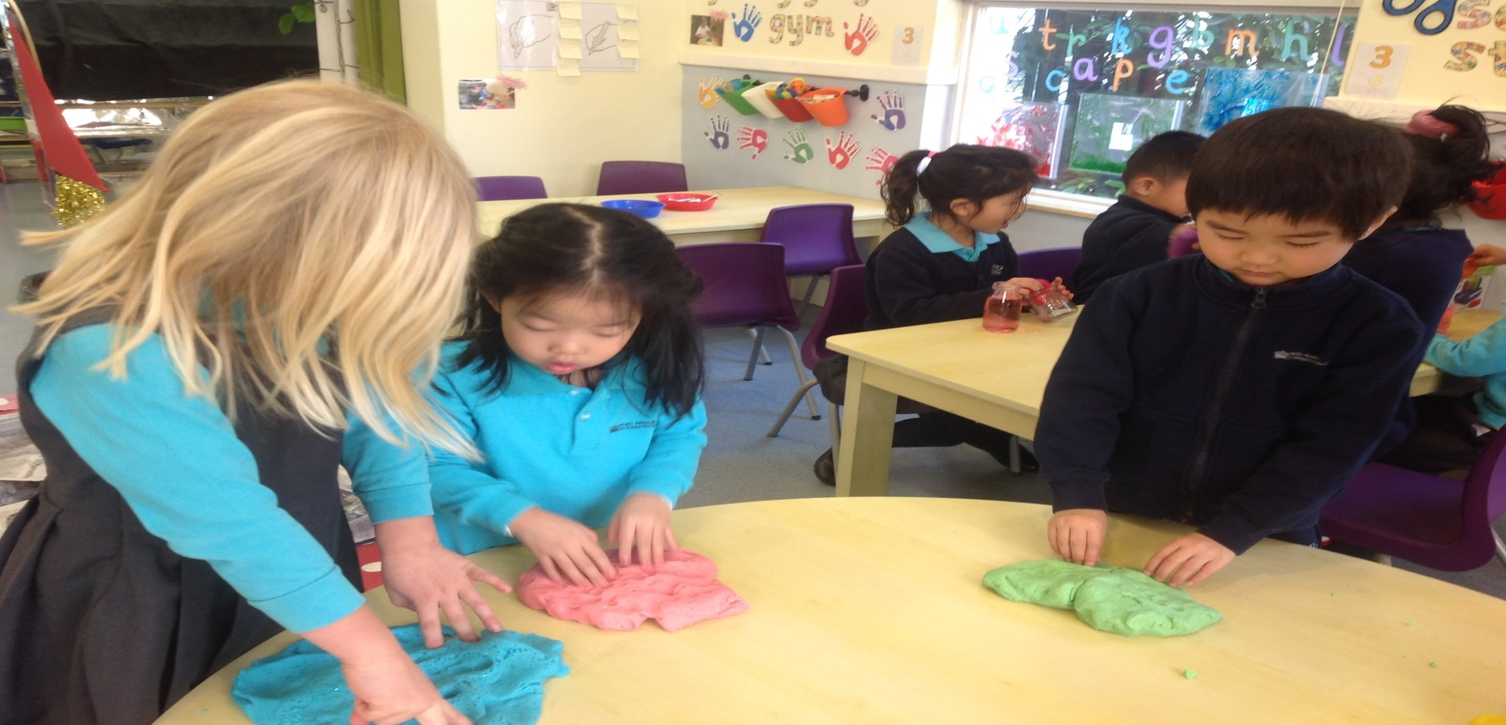
Nord Anglia International School Shanghai, Pudong Early Years Workshop on The Importance of Developing Fine Motor Skills by Kelly Downs and Tamara Keenan
15th February 2017

Slide 2
Our Aim
We want to help parents to gain a clearer understanding of the importance of fine motor development in Early Years. This workshop aims to explain the following points:
What is fine motor development?
Why is it so important?
How do we assess the children’s needs?
What do we do to help the children develop in school?
How can parents help at home?

Slide 3
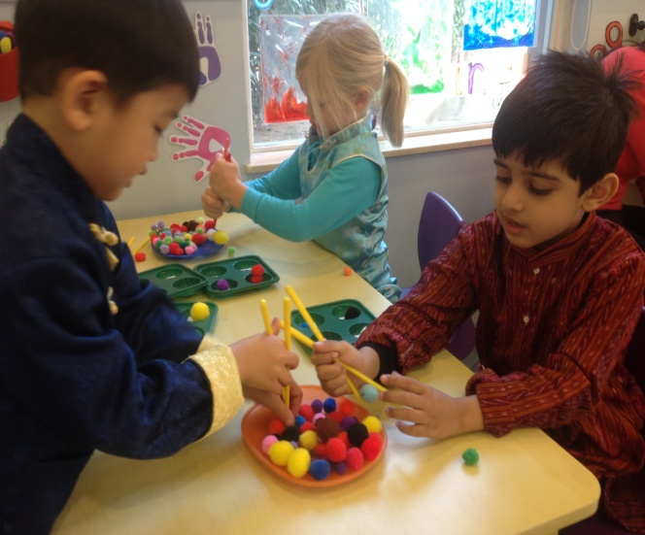
What is Fine Motor Control?
Pivot Development
Before children can master their fine motor control they must first embark on a journey of pivotal development.
Pivot development begins with the gross motor movements using the shoulder, elbow and wrist.
The journey then moves to the fine motor movements using the hands and fingers.

Slide 4
Why is Fine Motor Control important in Early Years?
Getting ready to write
Children entering Pre-Nursery are not developmentally ready to hold a pencil and write.
The physical ability to write requires great dexterity and muscle control, which in turn takes practise.
As children embark on their journey to becoming mark makers and writers they need to strengthen and develop their gross and fine motor dexterity, hand-eye co-ordination, proprioception, balance, low load control, grip and most importantly, their self-esteem!

Slide 5
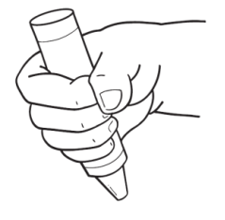
How do we know what each child needs?
Assessing grip development
We need to first assess the children to find out what stage they are at.
The ‘grip progress’ chart is used to support our assessments and to track children’s progress.
Each grip stage is linked to a pivot stage. Children operating at grip stage 1 are still operating at the shoulder and are therefore not ready to hold a pencil for writing.
Grip 1 | Grip 2
Grip 3 | Grip 4

Slide 6
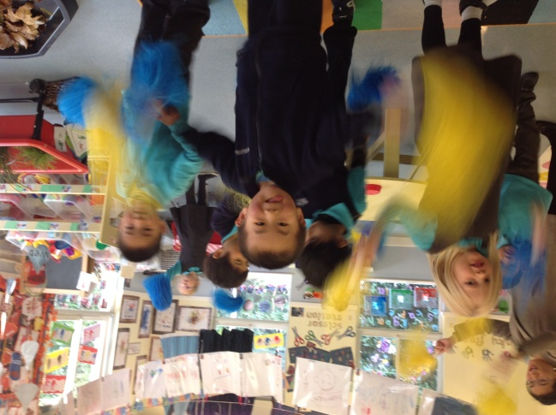
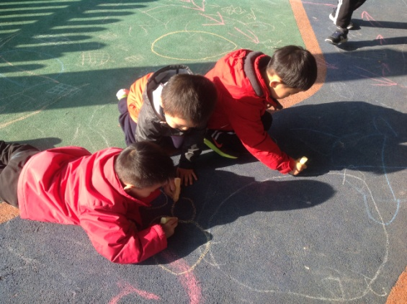
What do we do in school to support children?
Squiggle Whilst You Wiggle
Squiggle Whilst You Wiggle was developed by Shonette Bason-Wood.
It is a series of Neuro-developmental exercises which assist children in developing their gross and fine motor movements.
Children make big movements, such as up and down, side to side, circles and arches to music using pom poms or other props.
The movements are then transferred into marks which support children in number and letter formation.

Slide 7
Squiggle Whilst You Wiggle

Slide 8
What do we do in school to support children?
Dough Disco
Dough Disco was also developed by Shonette Bason-Wood.
It is designed to exercise the fingers, strengthening the muscles and developing fine motor control.
Children follow the adult to manipulate their dough using a series of actions such as squeezing, poking, rolling and slapping.
It is active, fun and done to fast music!

Slide 9
Dough Disco

Slide 10
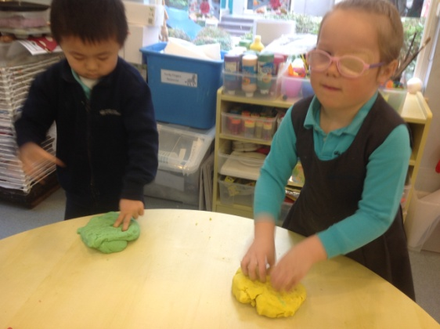
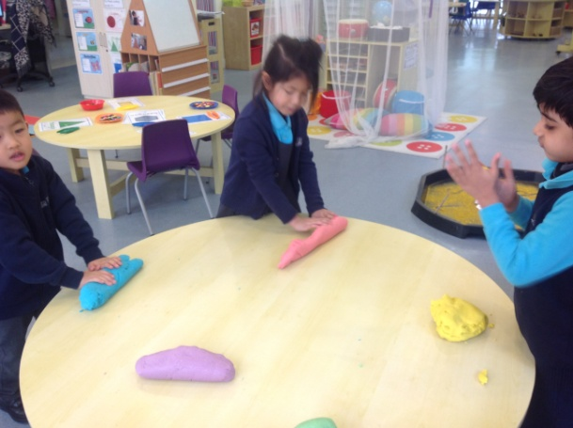
What do we do in school to support children?
Dough Gym
Dough Gym was developed by Alistair Bryce Clegg and is aimed at children who still need to develop their shoulder, elbow and wrist pivots and their gross motor strength.
Dough Gym is fast paced, fun and done in time to music.
It is an adult led, small group activity and can run alongside ‘Funky Fingers’.

Slide 11
Dough Gym

Slide 12
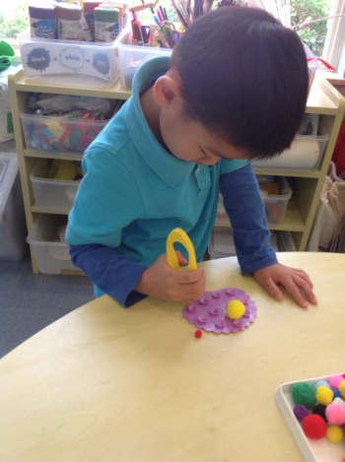
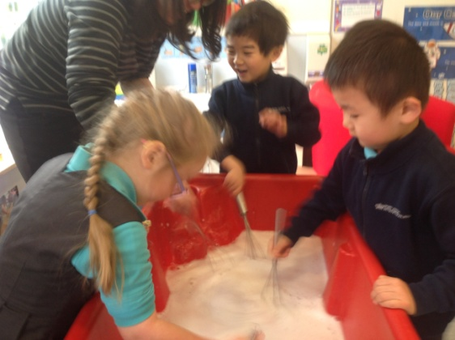
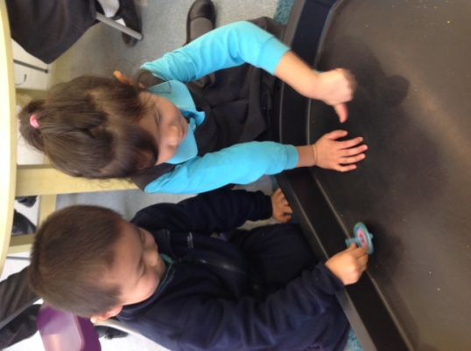
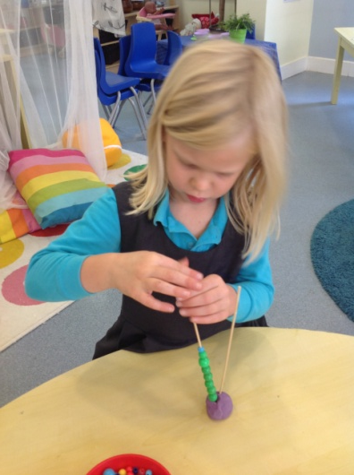
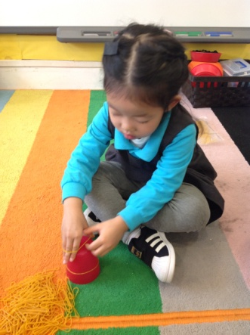
What do we do in school to support children?
Funky Fingers
Funky Fingers was also developed by Alistair Bryce Clegg and is aimed at supporting children who need more focused input on their hands, fingers and grip.
Funky Finger activities develop fine motor control and skills such as pincer grip, palm arches, in-hand manipulation, knuckle, PIP and DIP joints, bilateral co-ordination and hand/eye co-ordination.
Children work in small groups to music
As the children become more proficient in their skills, the dexterity challenge of the activities increases.

Slide 13
Funky Fingers

Slide 14
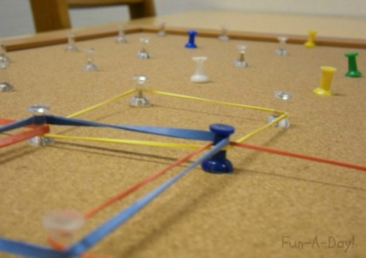
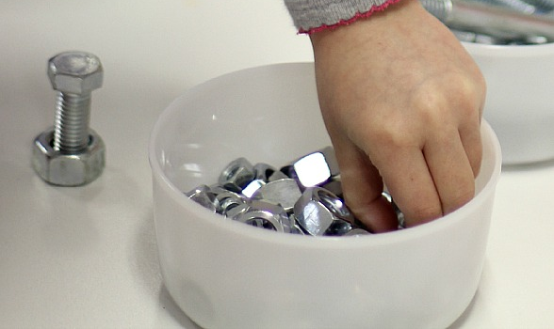
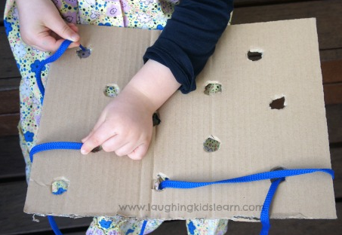
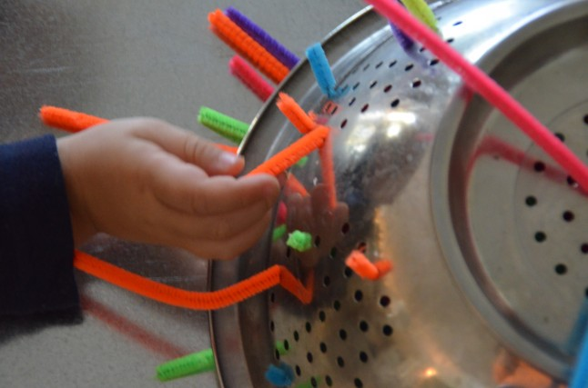
How can parents help at home?
Useful Links and Ideas to try at home...
Pinterest …a site where people share good ideas. Just type in ‘fine motor activities’ or ‘Funky fingers activities’ into the search box.
https://www.pinterest.com/
Alistair Bryce Clegg is the man behind Dough Gym and Funky Fingers. You can find out more about him and his approach at:
http://www.abcdoes.com/

Slide 15
Nord Anglia International School Shanghai, Pudong
Any questions?
Please don’t forget to take a handout!

Slide 16
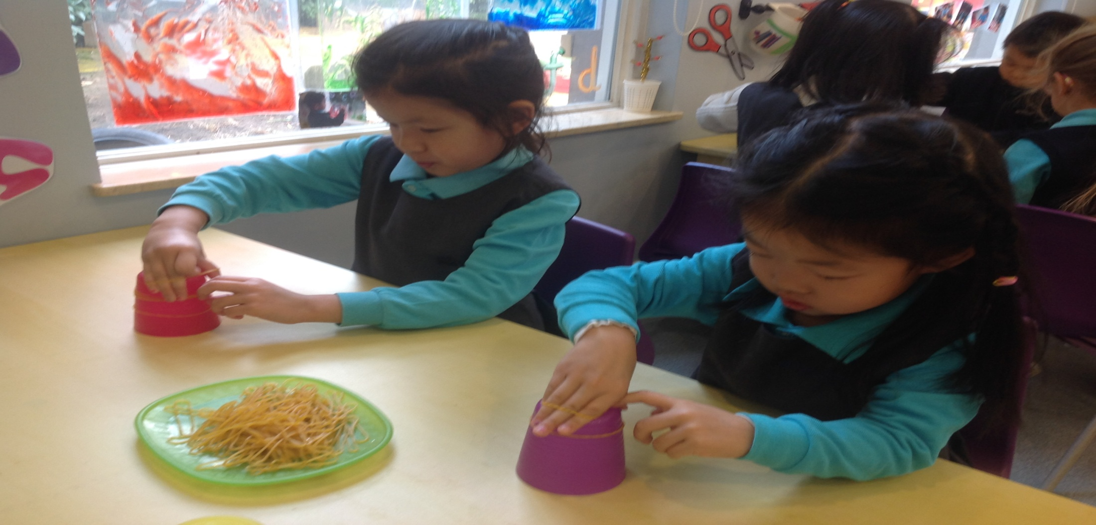
Thank you.
www.naispudong.com

