Slide 1
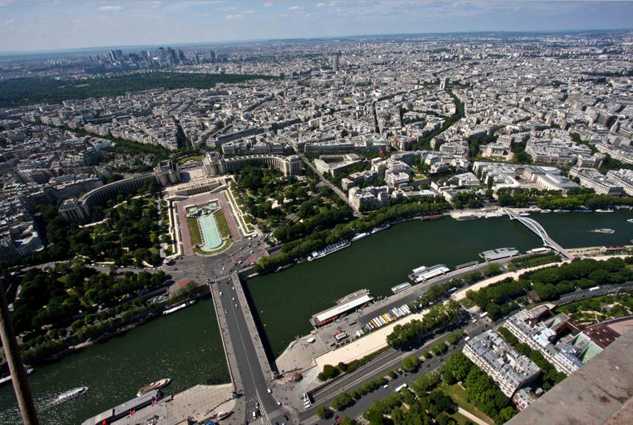
Nord Anglia International School

Slide 2
Contents
About Us
Your Destination
Your Itinerary & Accommodation
Star Attractions
Aims & Benefits of your Trip
What’s Included?
What next and further Questions

Slide 3
About us
Over 27 years of experience in the educational travel industry with over 20,000 students traveling with us every year.
We provide safe, high-quality, competitively priced tours that support classroom learning and we’re here to help group leaders tackle all the practicalities of taking a group away.
Our Experience
We share your passion for your subject. Most of us at Travelbound are experts in one or more subject fields, fluent in more than one language and have travelled extensively.
This mix of on-the-ground knowledge and subject expertise means we know how to make the most out of every step of your school trip.
Our
Passion
Part of TUI Travel PLC, we offer the highest level of financial protection. TUI’s global presence ensures that we have a year-round, worldwide support network .
We are proud to have been awarded full accreditation for the LOtC Quality Badge scheme, are a full member of the School Travel Forum and fully bonded by ABTA.
Our
Security

Slide 4
Contents
About Us
Your Destination
Your Itinerary & Accommodation
Star Attractions
Aims & Benefits of your Trip
What’s Included
What next and further Questions

Slide 5
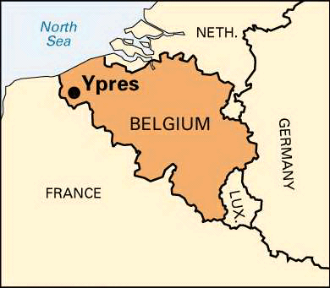
About Your Destination
YPRES, FRANCE
Information
Ypres, Belgium:
Ypres was one of the key battlegrounds during World War One, its position integral to the German advance on France. Known as a salient because it was exposed to the enemy on three sides, the town was extremely vulnerable and much of it was destroyed. Although the Germans never got the upper hand and were eventually forced to retreat, trench warfare developed, leading to several years of uncomfortable stalemate.

Slide 6
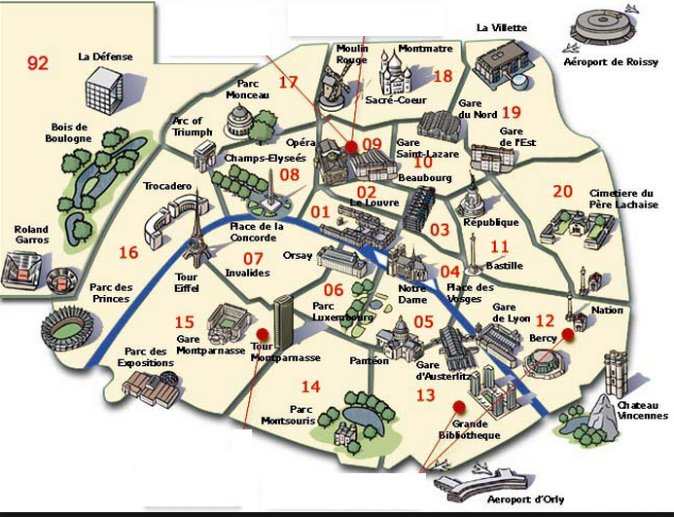
About Your Destination
PARIS, FRANCE
Information
Paris, France:
Population of Paris: 2.23 million
Paris is not the city’s original name – it is actually Parisiorum (called Lutèce in French) and it was the settlers there who were known as “Parisii”.
Average temperature ranges from 3⁰C in January to 19 ⁰C in July.
Paris has one of the densest metro networks in the world, with 245 stations within 86.9 km2 (34 sq mi) of the city of Paris

Slide 7
Contents
About Us
Your Destination
Your Itinerary & Accommodation
Star Attractions
Aims & Benefits of your Trip
What’s Included
What next and further Questions

Slide 8
Your Itinerary
Day | Visit, Excursions, Museums
Day 1 | Depart Dubai airport for your flight to Paris
Day 2 | Transfer to Ypres to check into your hotel/ Lunch at local restaurant / Visit the Chocolaterie Ledoux/ Dinner at local restaurant/ Overnight Ypres
Day 3 | Morning: Coming World Remember me WW Art Workshop/ Afternoon: Essex Farm, Hooge Crater, Hill 60, Hill 62 and Sanctuary Wood/ Dinner at local restaurant/ Menin Gate Ceremony/ Overnight Ypres
Day 4 | Morning: In Flanders Lodge Field Museum Educational Workshop/ Afternoon: Transfer to Paris/ stade de France guided tour/ Dinner at local restaurant/ Overnight Paris
Day 5 | Morning: Paris catacombs/ Tour Montparnasse/ Afternoon: St Germain Pastry and Chocolate Guided Tour/ Free time in Montmartre/ Overnight Paris
Day 6 | Arc de Triomphe and free time for shopping on Champs Elysees/ Eiffel Tower/ Shopping at Chatelet-Les-Halles/ Dinner at local restaurant
Day 7 | Full day: 1 park- choose from either the Disneyland or the Walt disney Studios/ Overnight Paris
Day 8 | Transfer from hotel to Airport
Images
Day 1
Morning:
-
-
-
-
Afternoon
-
-
-
-
Evening:
-
-
-
-

Slide 9
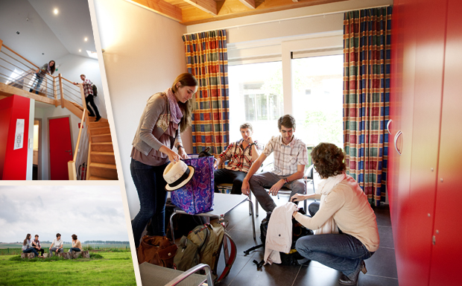
Our Typical Accommodation Offer
Ypres
Description
Based on Peace Village ( or similar)
32 bedrooms
View of the beautiful local landscape
Games room
Bar and conferencing facilities
Restaurant
Free wifi

Slide 10
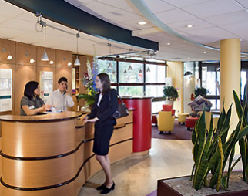
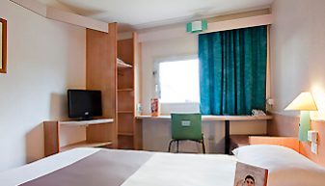
Our Typical Accommodation Offer
PARIS
Description
The tour is based on 3* accommodation located on Paris outskirts.
These accommodation units consist of typically multi bedded en-suite rooms.
All our accommodation providers are health & safety audited including fire detection, fire containment, fire-systems control, as well as smoke and people evacuation.
We are able to accommodate any specialist dietary requirements with advance notice prior to departure.

Slide 11
Contents
About Us
Your Destination
Your Itinerary & Accommodation
Star Attractions
Aims & Benefits of your Trip
What’s Included
What next and further Questions

Slide 12
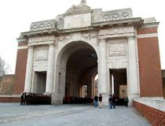
Star Attractions – Ypres
Photos
Chocolaterie Ledoux
A guided tour where visitors will see the whole production process from melting the chocolate until the finished product. The guided tour is followed by a tasting and the opportunity to buy chocolates.
Menin Gate Ceremony
This moving tribute to the courage and sacrifice of those who fell defending their town is an imperative experience for students connecting with WWI. Each night at 8pm the traffic stops around the Menin Gate memorial – six buglers from the fire brigade play the Last Post, Reveille and silence is upheld.

Slide 13
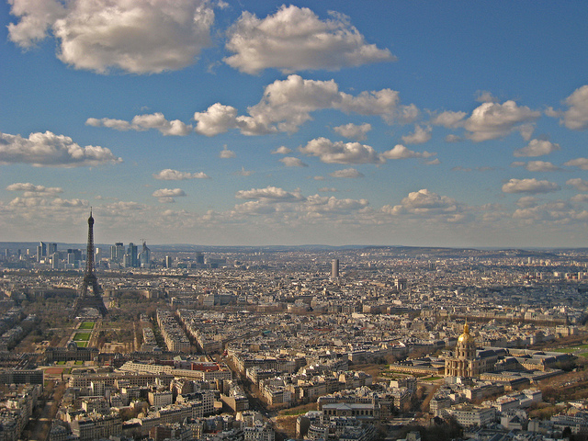
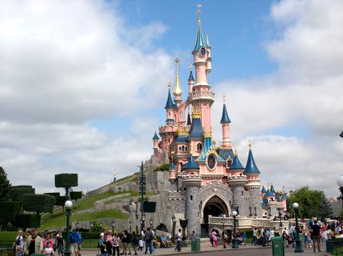
Star Attractions – Paris
Photos
Tour Montparnasse
Experience superb views of the Eiffel Tower and the rest of Paris from the 56th floor of the Montparnasse Tower and Paris’s highest roof terrace. This visit provides a very safe environment from which to understand the layout of Paris and admire its beautiful architecture with the aid of interactive touch screen viewpoint tables and multimedia kiosks.
Disneyland Paris
The main park of Disneyland® Paris, the action is spread out across five different themed lands. Highlights include more than 40 rides and attractions including Space Mountain, the Buzz Lightyear Laser Blast® and Pirates of the Caribbean, along with spectacular parades and shows.

Slide 14
Aims & Benefits of your Trip
Aims of the Trip
Benefits of the trip
Gain a better understanding of the events and experiences of soldiers in World War I
Gain a sense of the breadth of history
Visit a foreign country and experience another language and culture
Educational
First-hand experience of language, culture and history.
Personal
An experience of being away from home: personal organisation, co-operating & working with others in a variety of environments.
Enjoyment
Making new friends and forming strong bonds with classmates.
Development
An experience which can broaden the mind and inspire future trips and study options.

Slide 15
Contents
About Us
Your Destination
Your Itinerary & Accommodation
Star Attractions
Aims & Benefits of your Trip
What’s Included
What next and further Questions

Slide 16
What’s Included?
Excursions & Transport
Insurance, accommodation, food & Support
Return Indirect flights from Dubai to Paris,
Tour co-ordinator throughout your tour planning to book, support and complete your final itinerary to include any tickets and vouchers
24 hour emergency support on tour
Local office support located in Dubai
2 nights in Peace Village (or similar) in Ypres and 4 nights in 3* hotel accommodation in Paris
Full Board (breakfast, packed lunch and dinner)
Excursions and entrances mentioned in the itinerary
Return coach transfer to Disneyland Paris
Students based on multi-bedded room and Adults based in twin and single room.
Coach throughout from Day 2-4
2 Day Paris metro pass Zone 1-3
Fully comprehensive insurance included with no medical excess (you will not have to pay for any excess on medical claims)
Return airport transfers in France

Slide 17
Contents
About Us
Your Destination
Your Itinerary & Accommodation
Star Attractions
Aims & Benefits of your Trip
What’s Included
What next and further Questions

Slide 18
What next?
To confirm your child’s place on this trip, you will need to follow these simple steps:
BOOKING FORM
Complete and sign the parents booking form and return it to the school, with a colour photocopy of your child’s passport.
DEPOSIT AND REMANING BALANCE
Pay the non-refundable deposit to the school, and pay the remaining balance according to the payment schedule outlined by the party leader.
VISAS AND VALID PASSPORTS
Parent’s are responsible for ensuring that passports are updated and visa requirements according to their child’s destination are fulfilled prior to departure. Neither Travelbound or the school are responsible for any cancellation fees occurred due to unsuccessful visa applications. Please consult your local French embassy and/or the following website: http://www.diplomatie.gouv.fr/en/coming-to-france/

Slide 19
Your questions

Slide 20
Enjoy you Trip!

