Slide 1
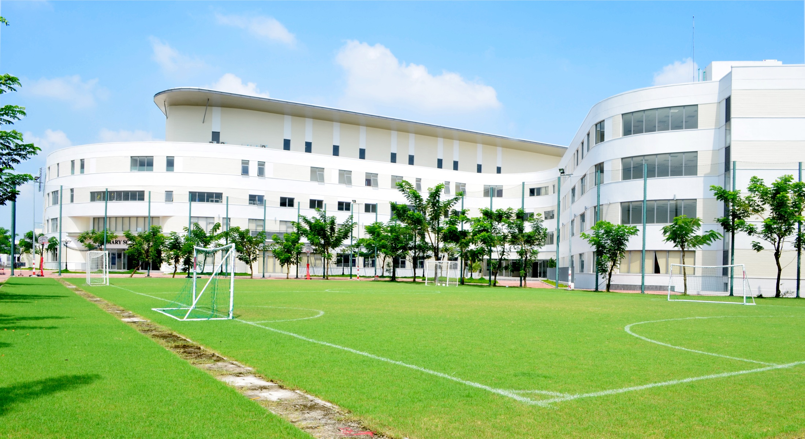
Welcome to the Early Years Foundation Stage at BVIS
Friday 31st May 2019

Slide 2
A Celebration of Learning

Slide 4
The Importance of Early Writing

Slide 5
What is early writing?
The act of making marks on paper
The meanings that a child gives to those marks
Understanding how written language works

Slide 6
The act of making marks on paper
This is called ‘Emergent Writing’
Children as young as 2 years old begin to imitate the act of writing
Often interpreted by adults as ‘directionless scribbles’
At this stage, it is very important for children to have as many different experiences with mark making tools and make both large and small movements.

Slide 8
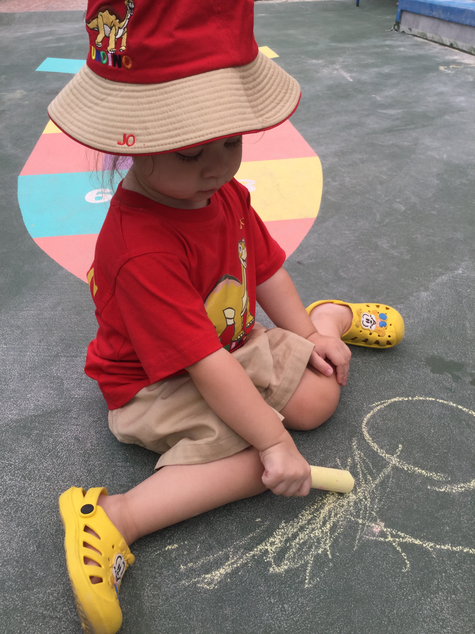
Examples of Emergent writing

Slide 9
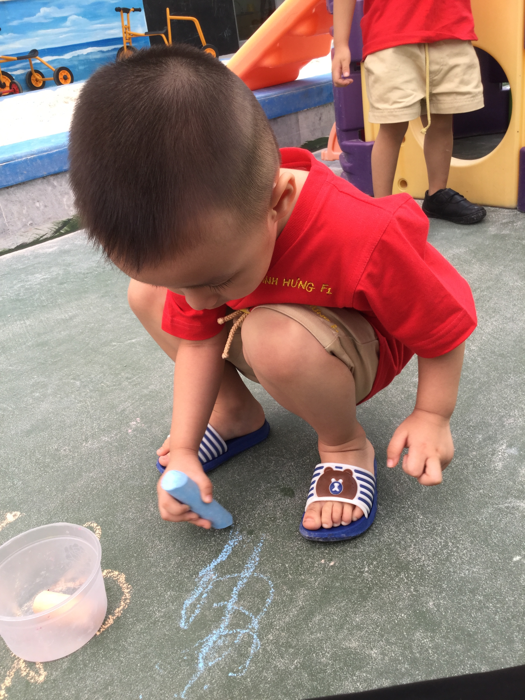
Examples of Emergent writing

Slide 10
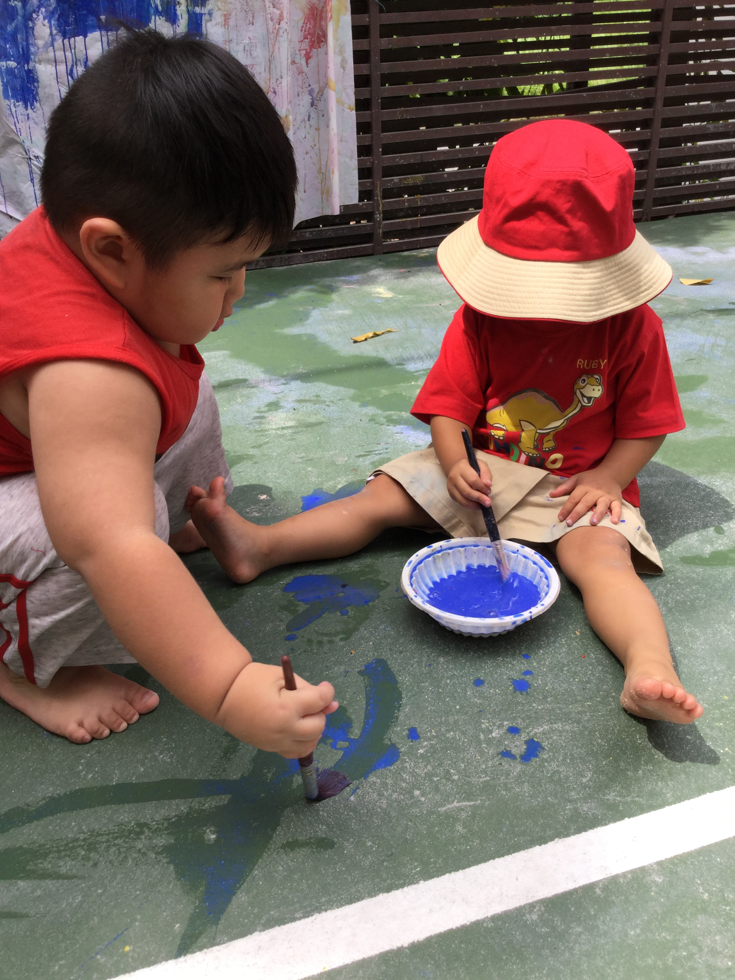
Examples of Emergent writing

Slide 11
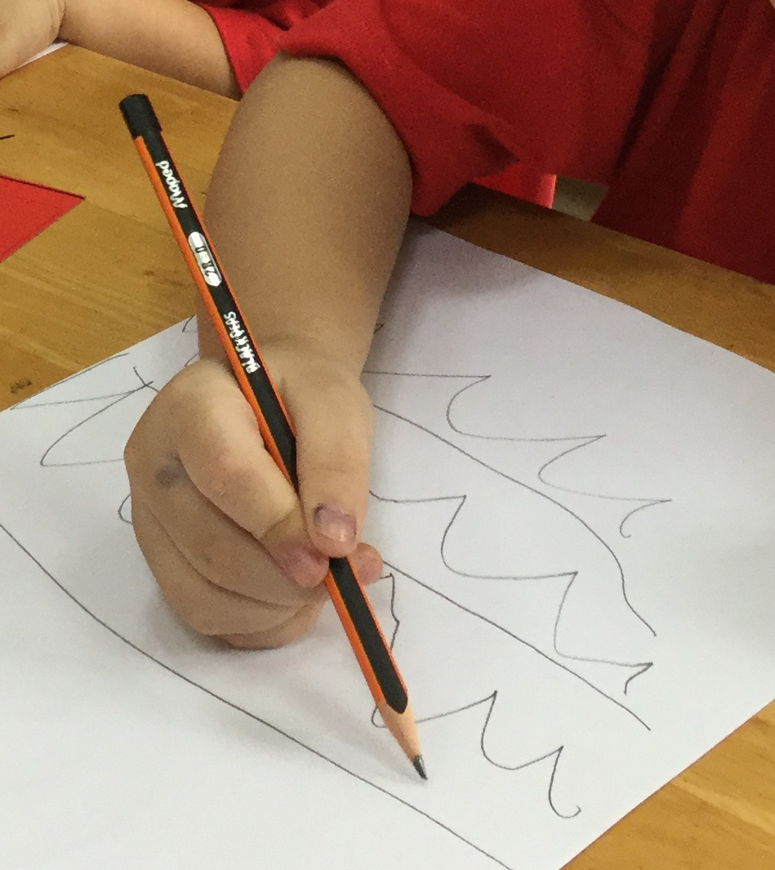
Examples of Emergent writing

Slide 12
Making Meaning
As children begin to understand language they tell an adult what their writing ‘says’
Children will often draw a picture and then label it with ‘words’ or write a ‘story’ to explain what it is
Children will begin to copy words and letters that they see, but they may not make any sense and will often be written back to front
Children will often make links to print in the environment, such as labels on food or familiar word and logos

Slide 14
Examples of Emergent writing

Slide 15
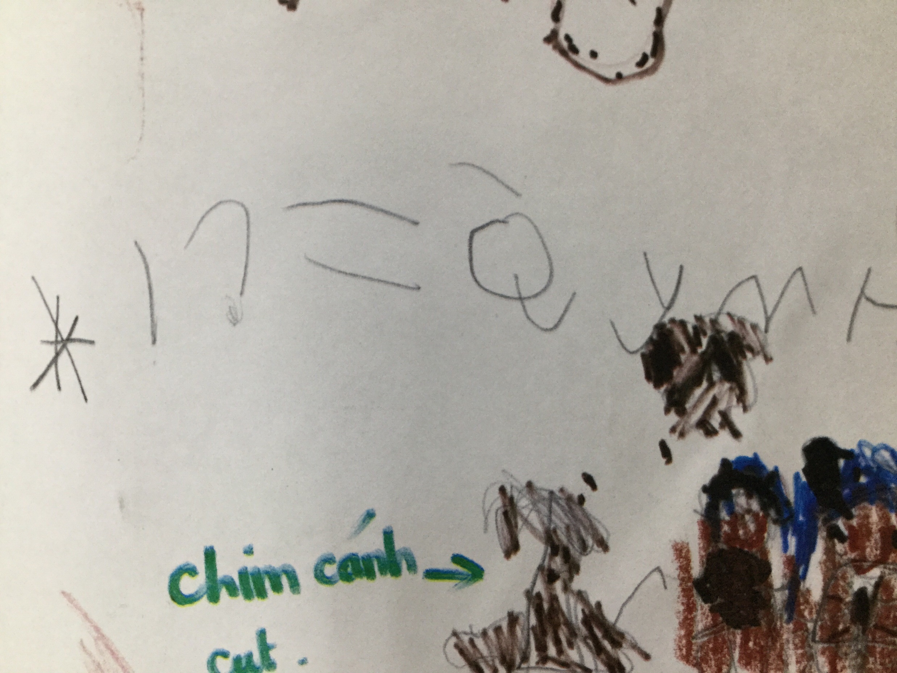
Examples of Emergent writing

Slide 16
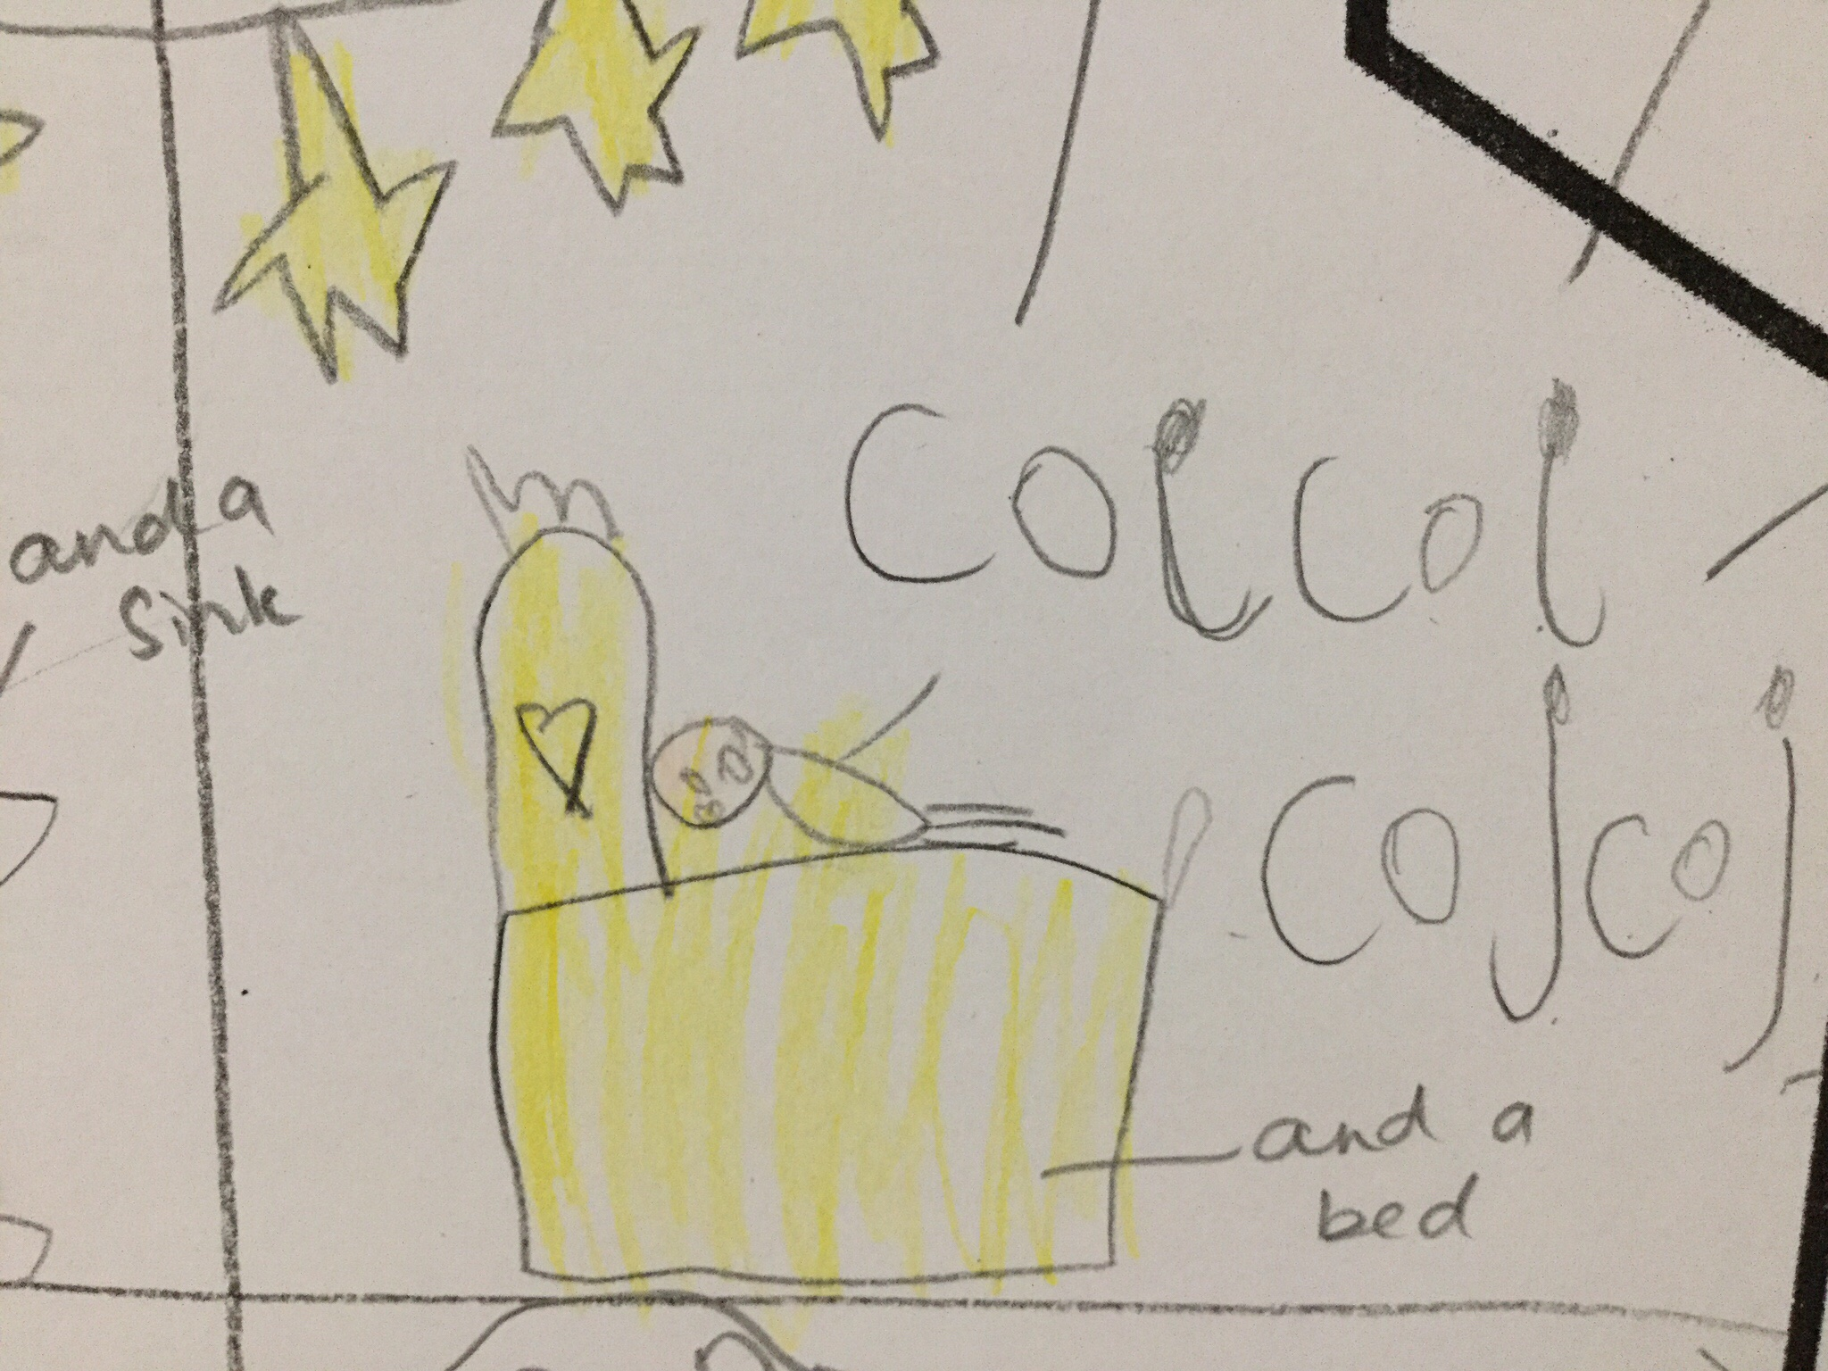
Examples of Emergent writing

Slide 17
Examples of Emergent writing
Understanding language
In order for the progression of writing to occur, speaking to the child is vital to enable them to understand that the spoken word can be written down.
As children begin to learn phonics and understand letter shapes, emergent writing begins to change again, with children understanding more about what they are writing or trying to write.

Slide 19
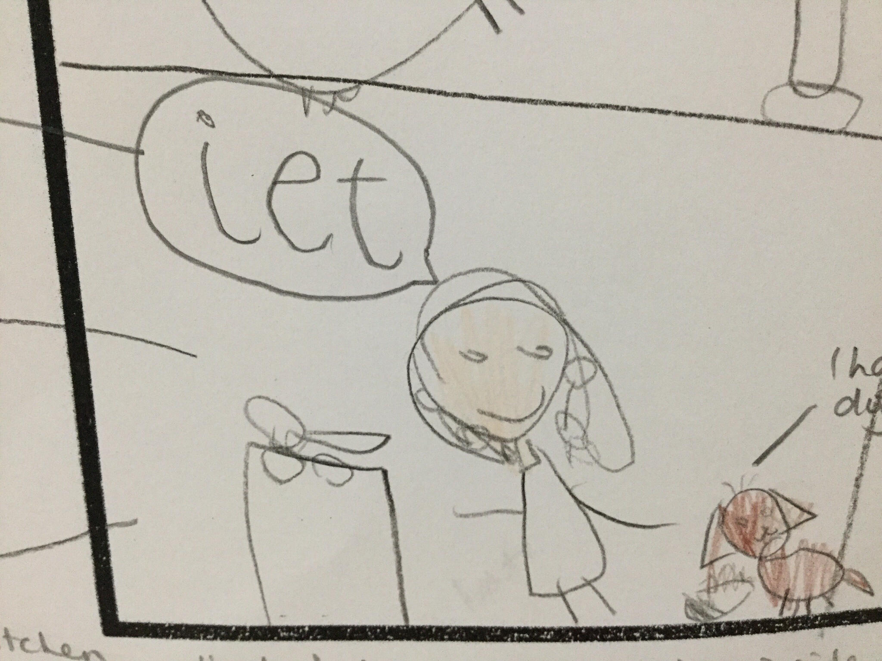
Examples of Emergent writing

Slide 20
Examples of Emergent writing

Slide 21
Examples of Emergent writing

Slide 22
Stages of pencil grip and the importance of fine motor development

Slide 23
There are 7 stages of pencil grip that a child goes through as they are learning to write.
The way in which we encourage and support children to draw and engage in activities that support this development are important.
These are the different stages of pencil grip that you may see as your child develops.

Slide 24
F1 children usually…

Slide 27
F2 children usually…

Slide 28
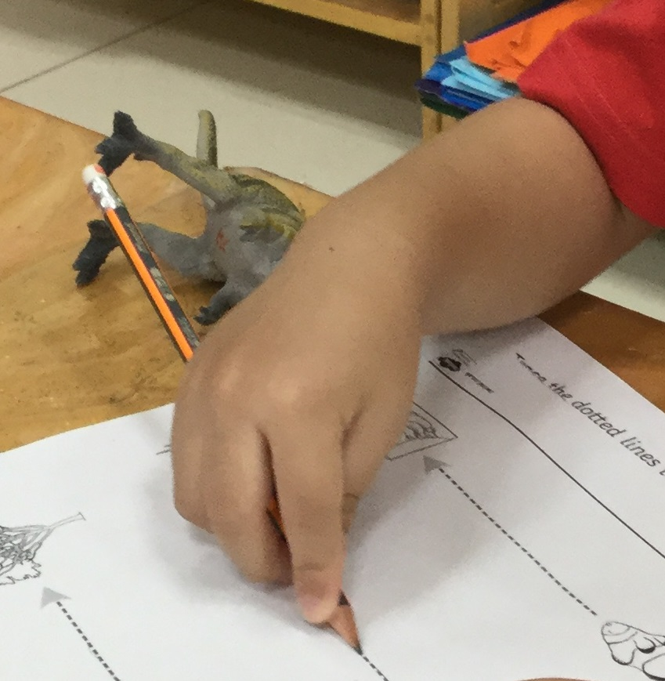

Slide 31
F3 Children usually…

Slide 35
Final stages of development…

Slide 36
It doesn’t matter what hand your child writes with, if you support their fine and gross motor skills, their handwriting will be fine!

Slide 37
Activities in the classroom

Slide 38
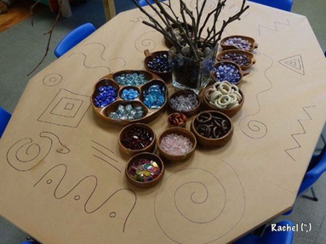
F1
Activity 1
With parent support, the children will arrange objects along the lines to become familiar with different ways to make marks. The children will also be encouraged to use markers to trace these lines to develop their fine motor skills and pencil grip.
Activity 2
Window painting. Using big movements, parents and children are encouraged to paint the windows in the classroom with designs and pictures of their choice.

Slide 39
F2
Parents will take part in 2 activities with your children – Dough Disco and then Write Dance. Both of these activities help to strengthen the hands and muscles needed for writing.

Slide 40
F3B – Activity 1 - Using the Interactive board to make detailed pictures and drawings. Activity 2 - Using phonics do some writing with your children about yourselves.

Slide 41
F3V – Activity 1 – Speech Bubbles – writing what the characters are thinking and saying Activity 2 – Camping Words – writing the different words to do with camping

