Slide 1
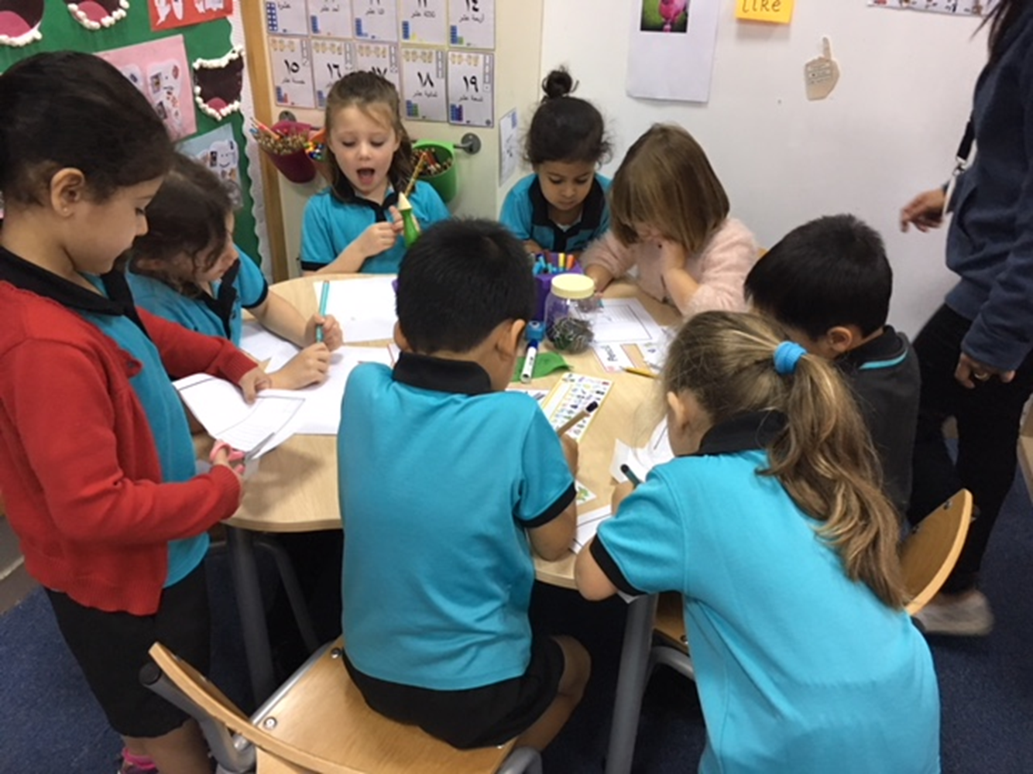
Welcome
أَهلًا وَسهلًا
FS2
Writing workshop
Notes:
Heather

Slide 2
Contents
1. Where did it all begin?
2. Expectations by the end of FS2
3. Phonics-group activities
4. Guided writing and spelling
5. Teaching writing through play/Writing for a purpose
6. Activity time!
7. How to help your child at home
8. Question time
Notes:
Heather

Slide 3
Where did it all begin?
At the beginning of FS2, some children could…
Recognise and write some letters in their play
Recognise and write their own name
Read simple words
Notes:
Heather

Slide 4
What do we expect to see by the end of FS2?
Writing ELG
They write simple sentences which can be read by themselves and others.
They also write some irregular common words.
Some words are spelt correctly and others are phonetically plausible.
Show an awareness of punctuation – capital letters, finger spaces and full stops.

Slide 5
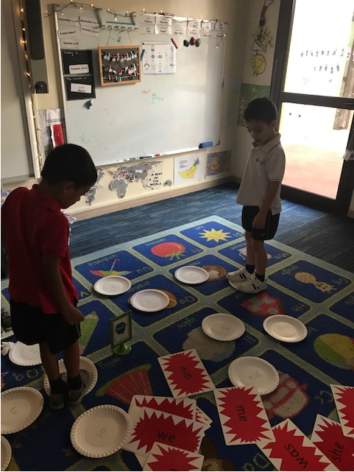
Phonics group activities
4 activities
Guided Writing-Hold a sentence
Reading activity with an adult
Tricky word activity
Independent reading or writing activity

Slide 6
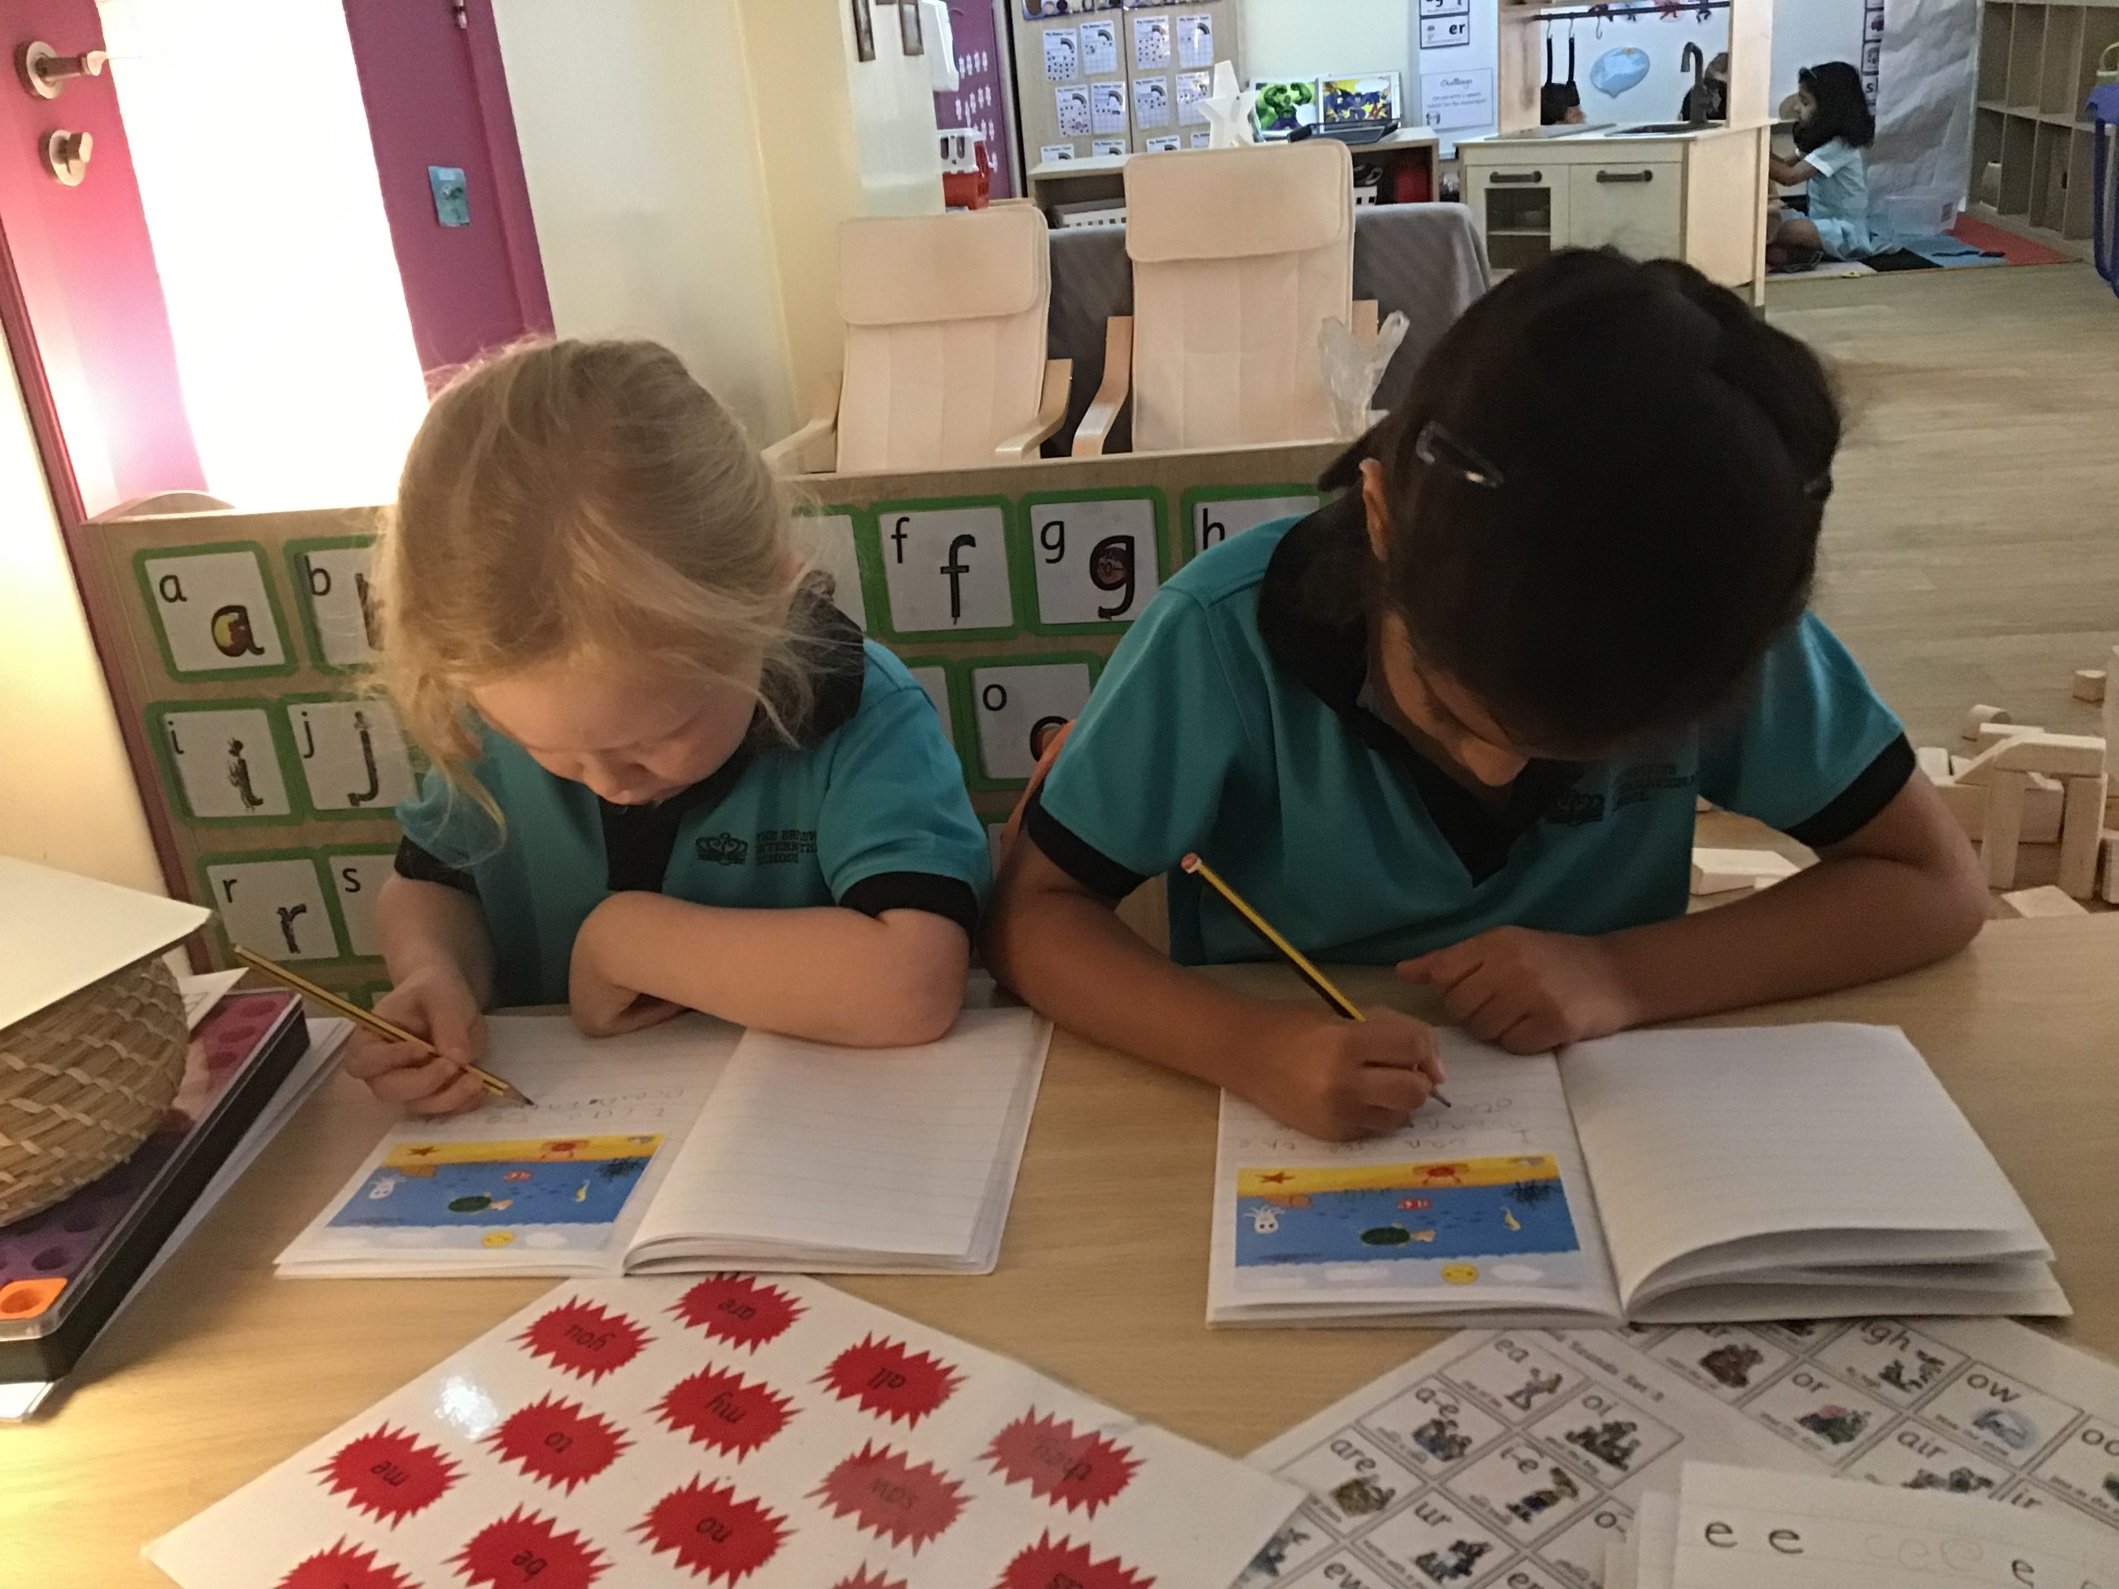
Guided Writing
Word writing
Say the word several times.
Encourage children to count the sounds they can hear in a word.
E.g. h-a-t has 3 sounds. E.g. sh-ee-p also has 3 sounds.
Encourage children to use their sound mat.
Read the word again.
Caption/Sentence writing
Say the sentence repeatedly in different ways.
Count the words in the sentence.
Model segmenting one word at a time, over emphasising sounds when necessary.
Ask “Which special friends can you hear?” “What tricky words are in the sentence?” Encourage children to use their sound mat.

Slide 7
Composing a sentence
Notes:
Ruth

Slide 8
Spelling
To begin with, when writing a sentence, children might only write the initial sound of each word.
V r iz s
This will then progress to 2/3/4 sounds in a word. However spelling may still be incorrect as we encourage children to write phonetically. Children are taught sounds in a specific order to help them write a range of words quickly. For example one of the first diagraphs taught is ‘ay’.
The raynbow iz in the scigh.
This is not saying children can not and should not be corrected and taught the correct spellings when they are ready. Children will begin to learn simple spelling rules towards the end of FS2.

Slide 9
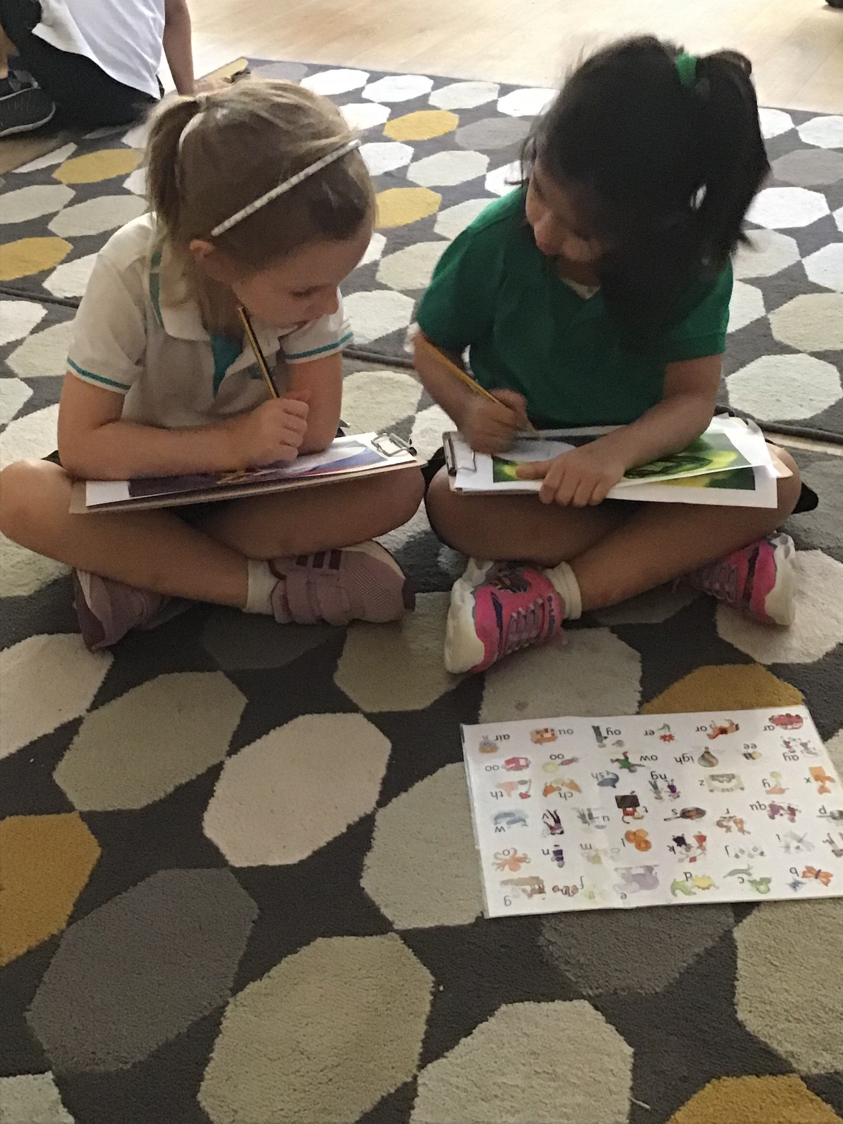
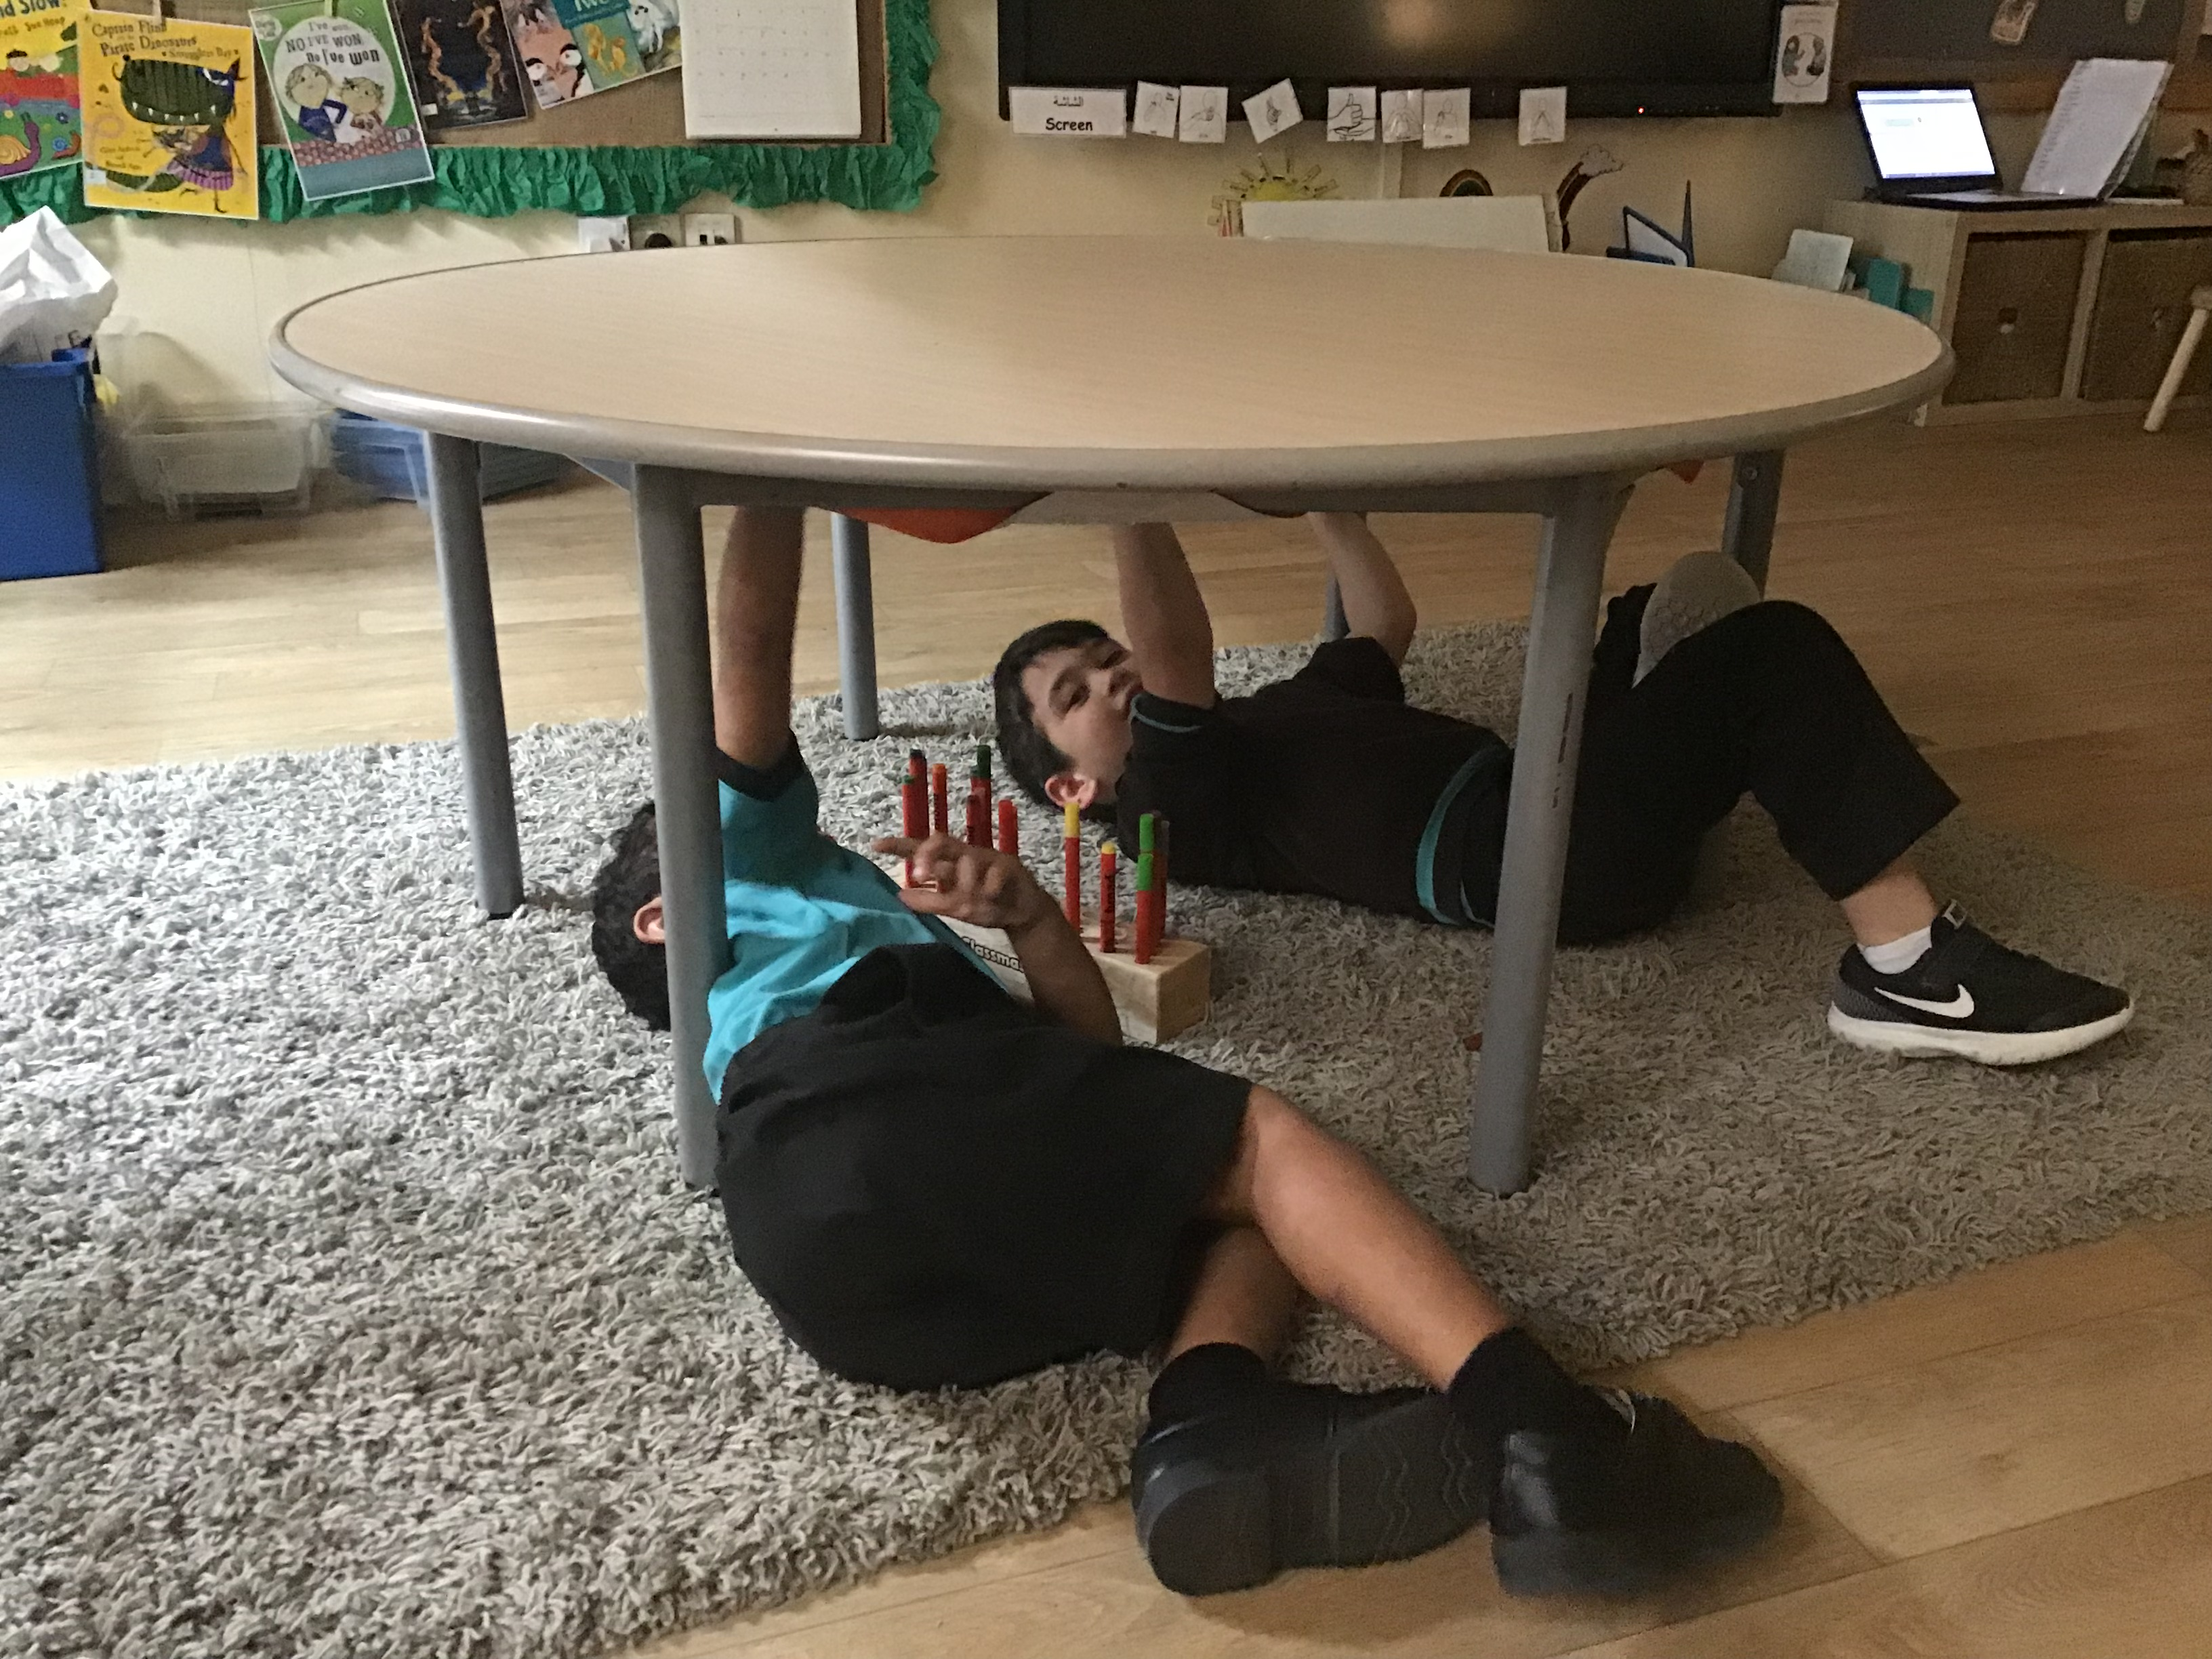
Continuous Provision Activities
Notes:
Ruth

Slide 10
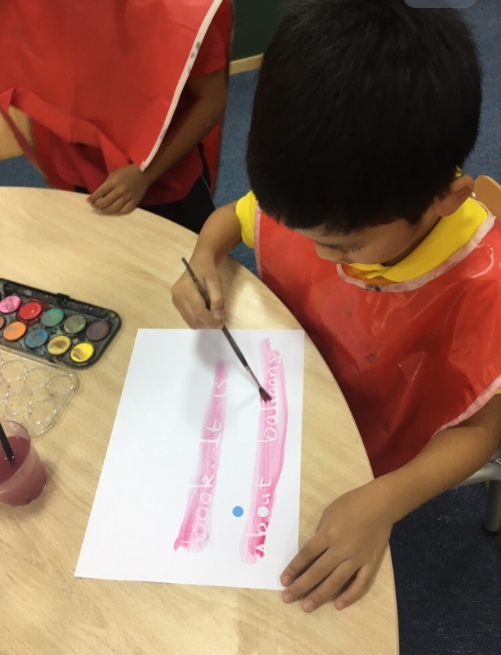
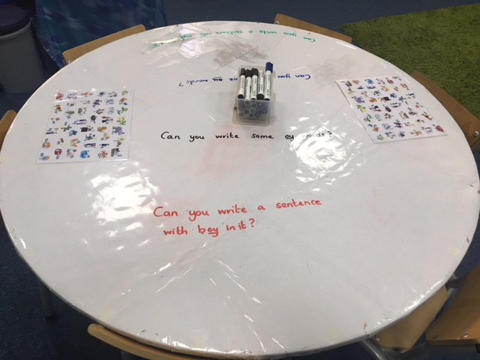
Continuous Provision Activities
Notes:
Ruth

Slide 11
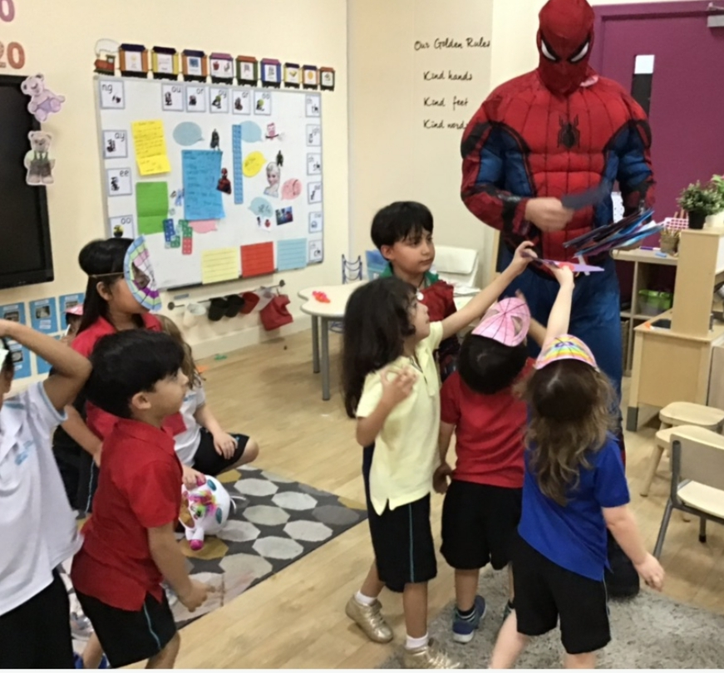
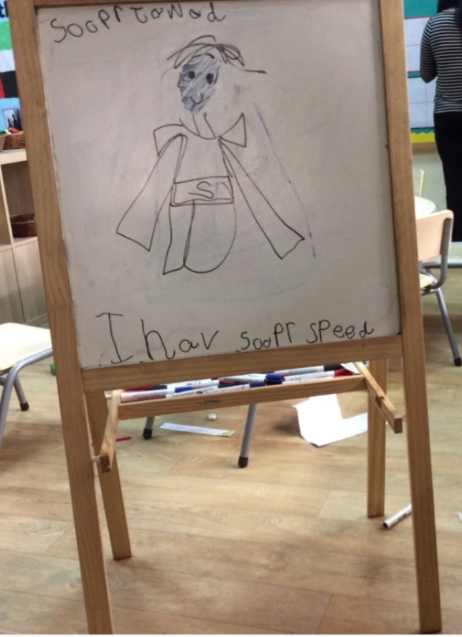
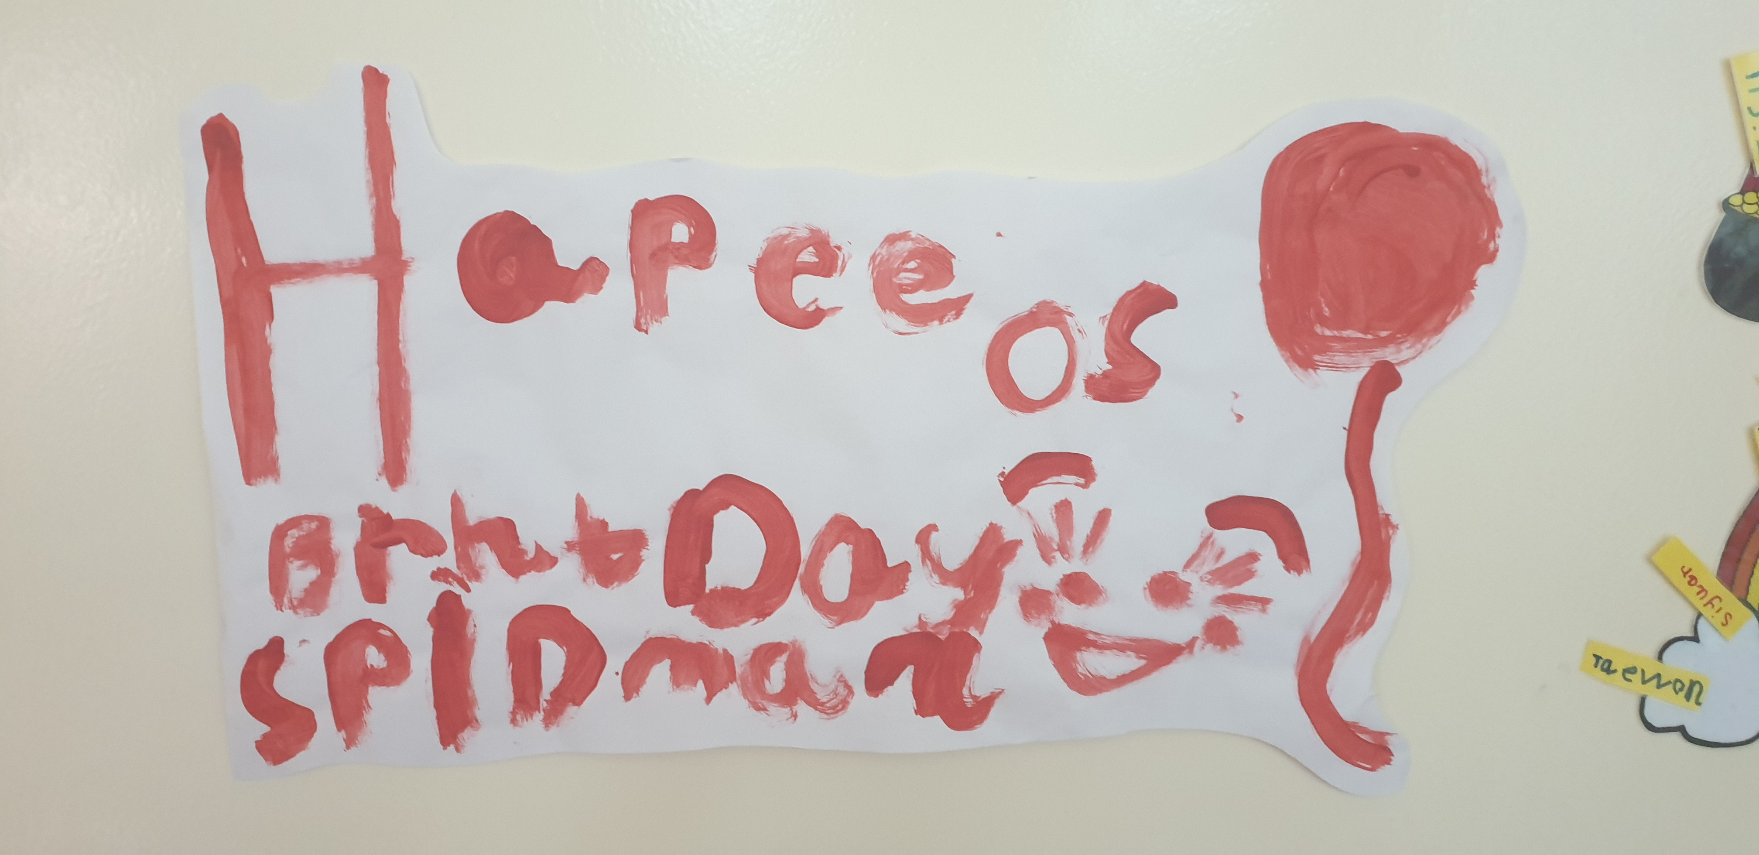
Writing for a purpose
Notes:
Emma

Slide 12
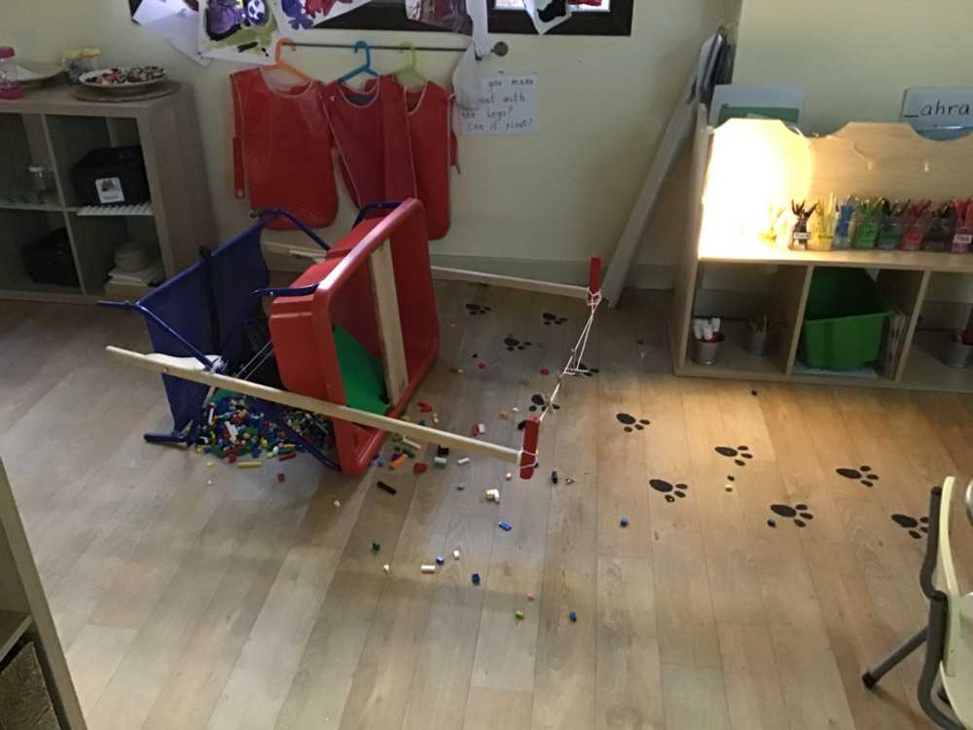
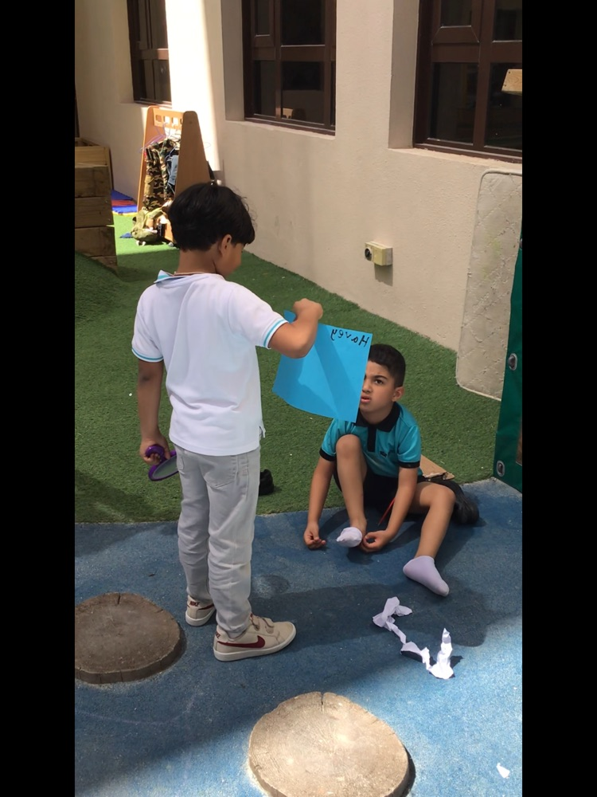
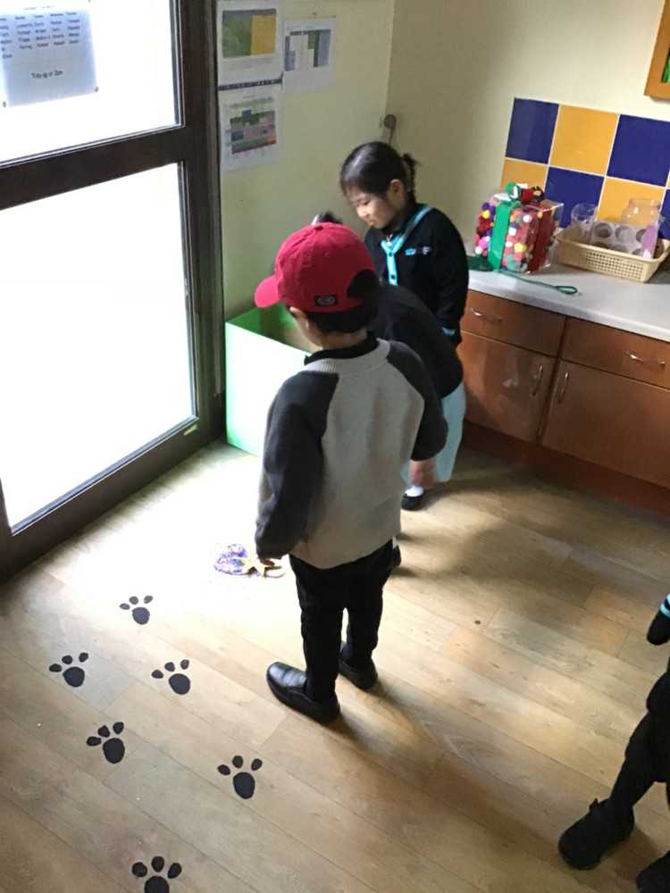
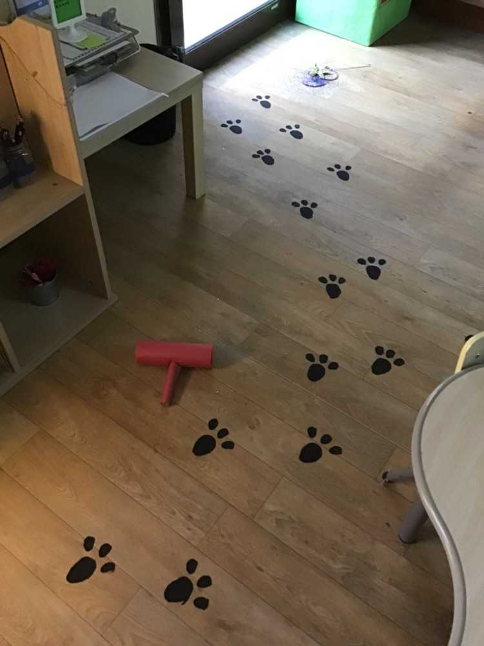
Writing for a purpose
Notes:
Emma

Slide 13
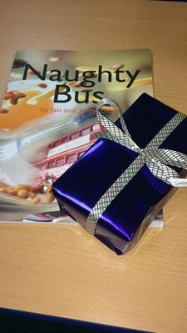
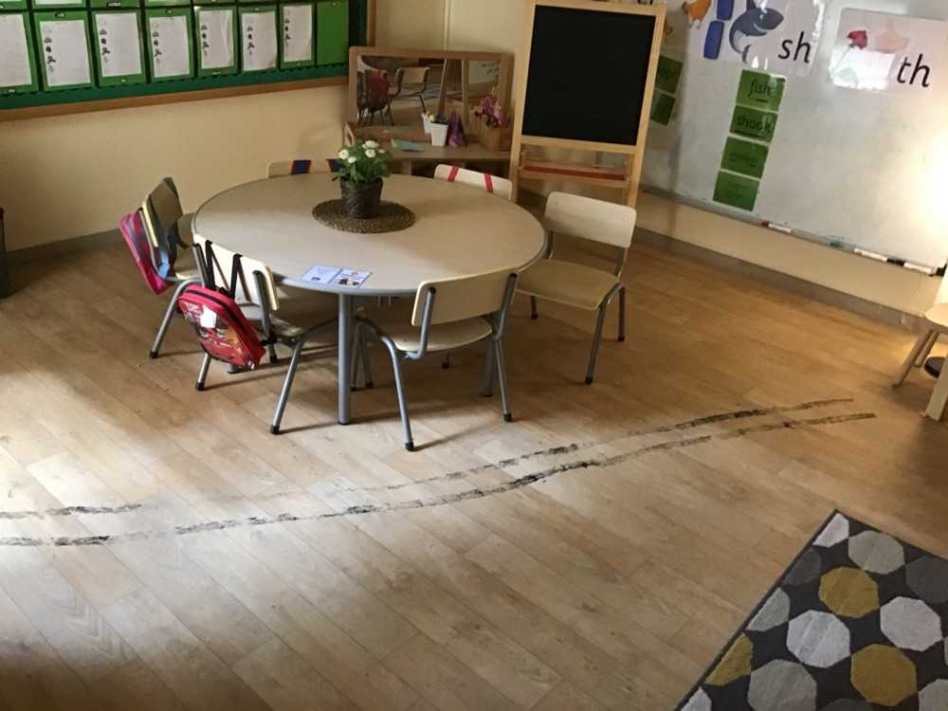
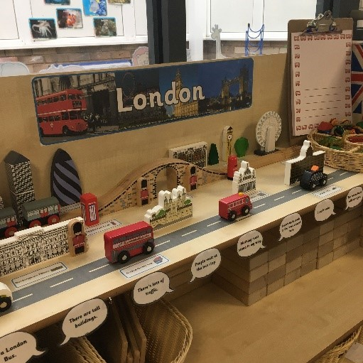
Writing for a purpose
Notes:
Emma

Slide 14
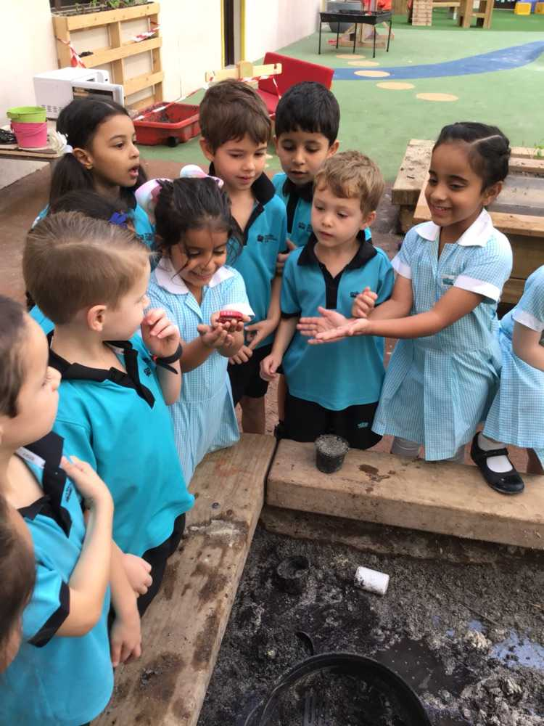
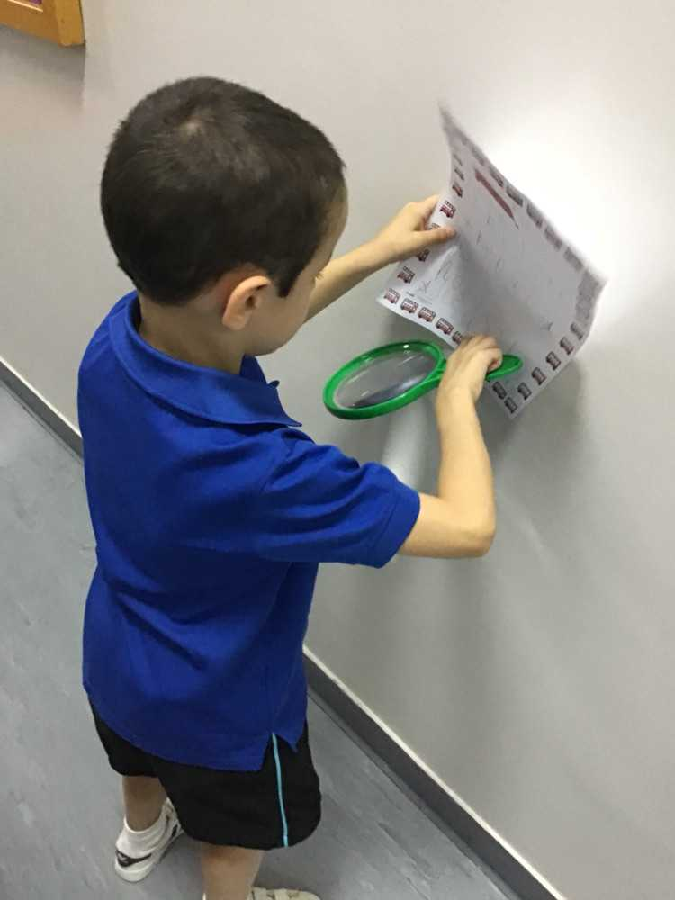
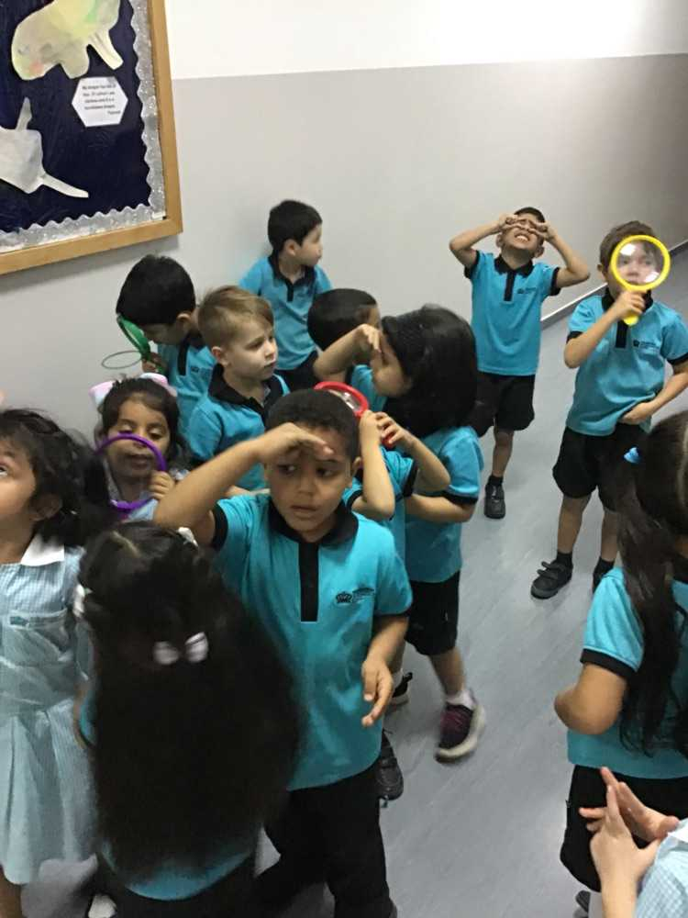
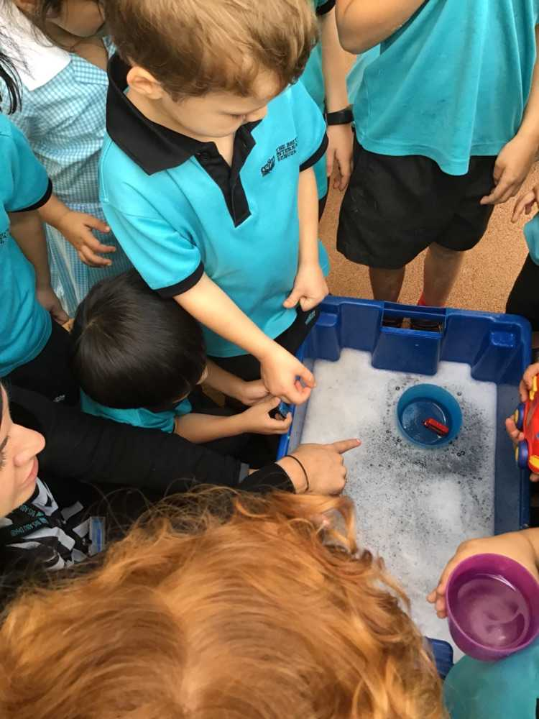
Writing for a purpose
Notes:
Emma

Slide 15
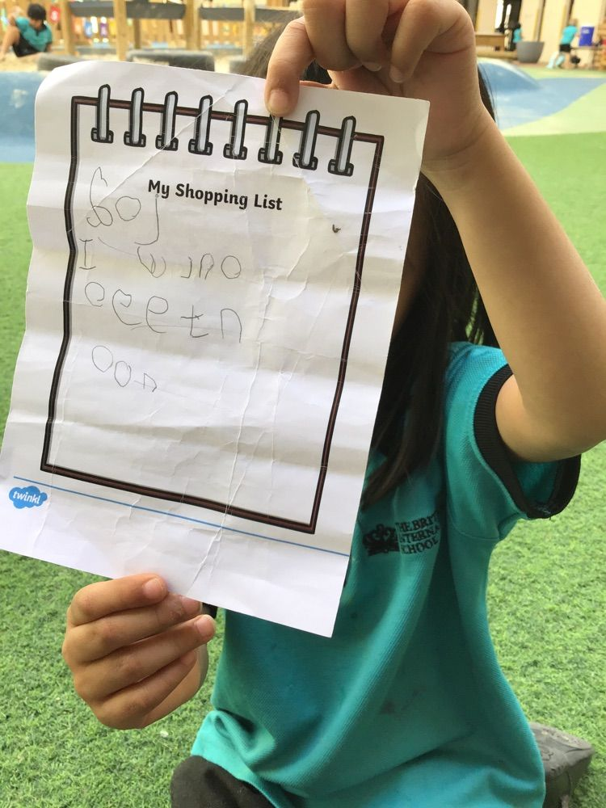
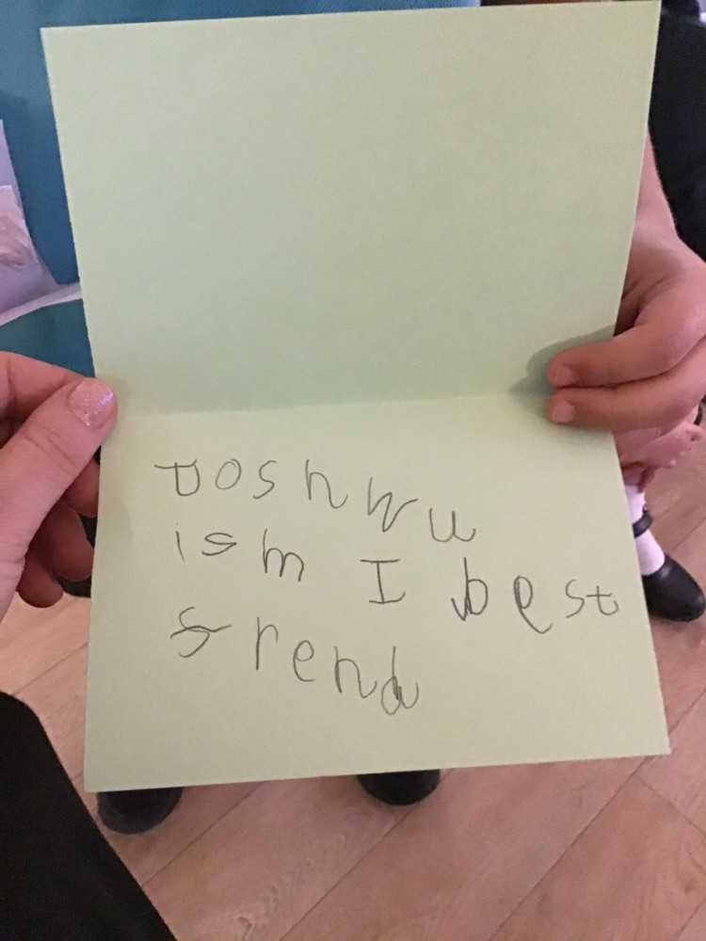
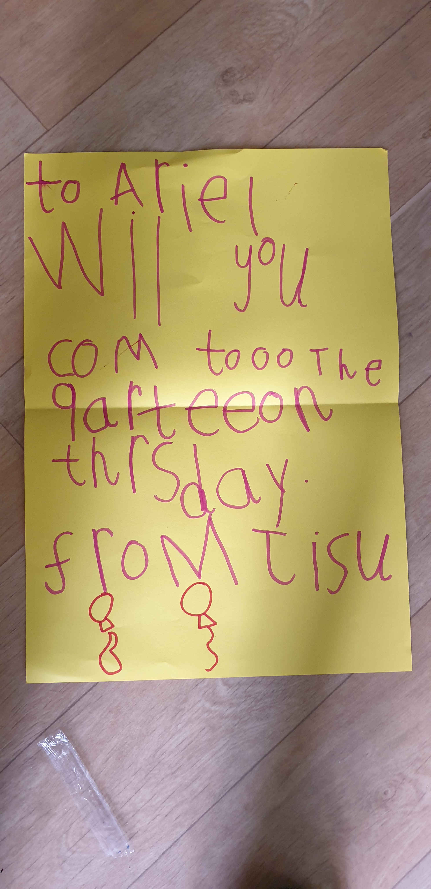
Writing for a purpose
Notes:
Emma

Slide 16
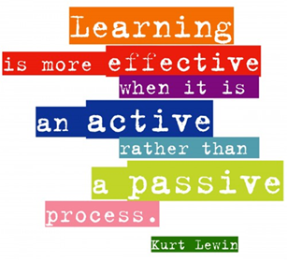
Now it’s your turn…
Notes:
Ruth

Slide 17
Ways to help your child at home
• Pointing out letters and words in the environment.
• Encourage fun writing for purpose, e.g. shopping list, labels, invitations etc.
• Keep a holiday scrap book or journal. Tell us about your weekend news.
• Send postcards or letters to us at school.
• Writing in different ways- under the table, invisible ink, on a clipboard, chalk outside, with a wet paintbrush on a chalk board.
• Encourage children to type when using technology. With careful adult supervision, allow children to type into a search engine instead of doing it for them.
• Letter formation & name writing
• Apps on the iPads that allow children to practise their blending and segmenting skills. E.g. Phonics play
Notes:
Heather

Slide 18
Q & A
Thank you for coming!
Goodbye! إلى اللقاء
www.bisabudhabi.com

