Slide 1
How is the World changing?
AUD $ Per Annum
?
$46,000
$40,000 - $75,000
$60,000
$70,000
$70,000
$77,000
USD $75,000
$82,000
$83,000
Digital Entrepreneurs
Creative Content Specialists
Cultural and Market Influencer
Green Architects (Retrofit Experts)
User Experience (UX) designers
Health Information Managers
Digital Strategist
Chief Listening Officers
Data Scientists
Sustainability Analyst/Managers
NEW TO THE WORLD

Slide 2
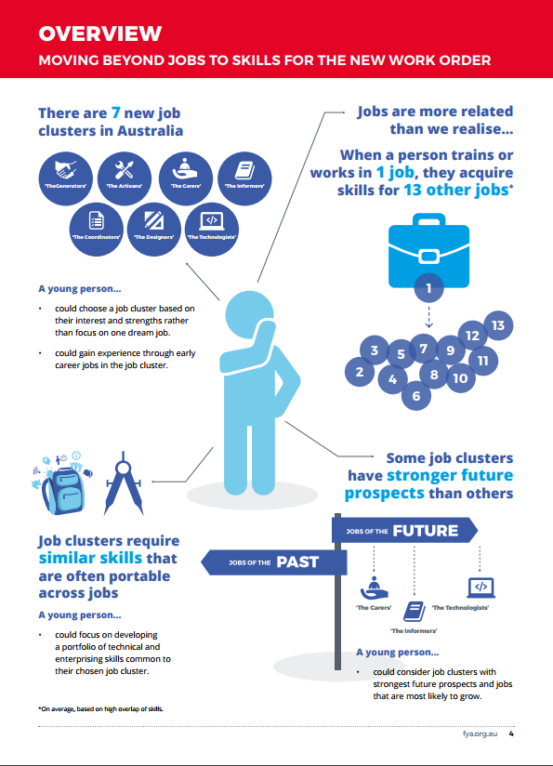
From fya.org.au
How do we start to think about jobs of the future?

Slide 3
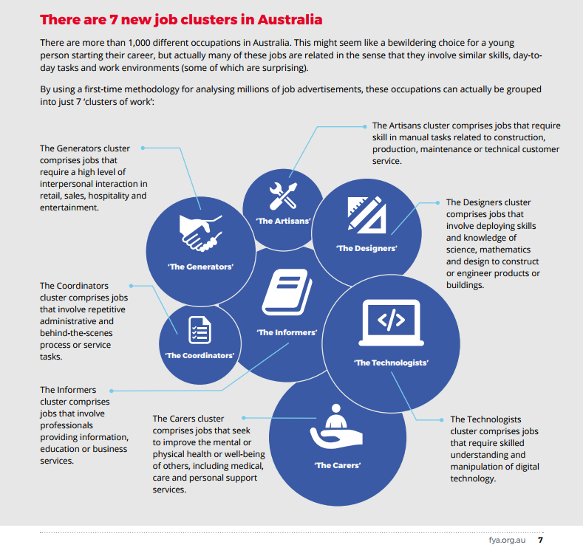
IT CAREERS PANEL

Slide 4
Skills of the 21st Century
Analysing and decision making
An awareness that knowledge is evolving
Dealing with complexity and ambiguity
Understanding the limitations and opportunities of methodologies and data
Creating User focused experiences
Understanding the balance between efficiency, safety, comfort, pleasure and effectiveness
Visualising and creating solutions in practical and creative ways
Challenge the way we approach existing solutions
Security
Understanding the impact of identity and power in the way human society works
Improving reasoning and critical analysis of perspectives
Understanding the role and impact of communication, conflict, negotiation, and collaboration
Understanding digital literacy and the complexities of technology-driven solutions
Enabling digital human interactions
Automating the world
Creating new solutions through technologies

Slide 5
Alumni
Morgan Koegel completed her Bachelor of Arts (Literature and Creative Writing) and JD, and went on to be CEO of One Girl.

Slide 6
What about the Professions
Accounting
The Big Four no longer just recruits accounting majors. Automation means more time for analysis and informed decisions.
Business analysis in different industries. Taxation and law becomes crucial.
Law
A need to keep up with societal trends, driven by technological advances.
Exposure to international and collaborative expertise. Examining their relationship with the Government of the day.
Engineering and Architecture
Both are also impacted on by the ICT revolution. Creativity is becoming a key skill and ability to work in interdisciplinary ways becomes crucial.
Solutions have to be based in society and environment, and be creative.
Medicine
The role of technologies in health is undeniable. The profession in fully dependent now on the technologists.
Medical practitioners also will have to contend with societal inequalities, as the world becomes more connected.

Slide 7
Alumni
Gabrielle Lim (Bcom, 2011) is a successful institutional banker by day and escape room designer extraordinaire by night. Co-founder of TRAPT

Slide 8
Alumni
Andy Sum completed his Master of Engineering (Software) and is a co-founder of Crossy Road! Currently working on a new gen PacMan.

Slide 9
How can Students improve their Employability?
Technical and Content Competence
Confidence
Communication
Knowledge of Cultures
Knowledge of the Industry
Understanding Employer Expectations
Doing well in a good Degree
Practice and Networking outside Comfort Zone
Improving Language Skills and Networking
Interact Across Cultures
Research on and Network with Industry
Network with Industry

