Slide 1
assessment & reporting
PRESENTED BY TAMARA MCKENNA
November 2022

Slide 2
Overview of today
Rationale behind our reporting approach
What do the reports tell you?
How do they help you to support your child?

Slide 3
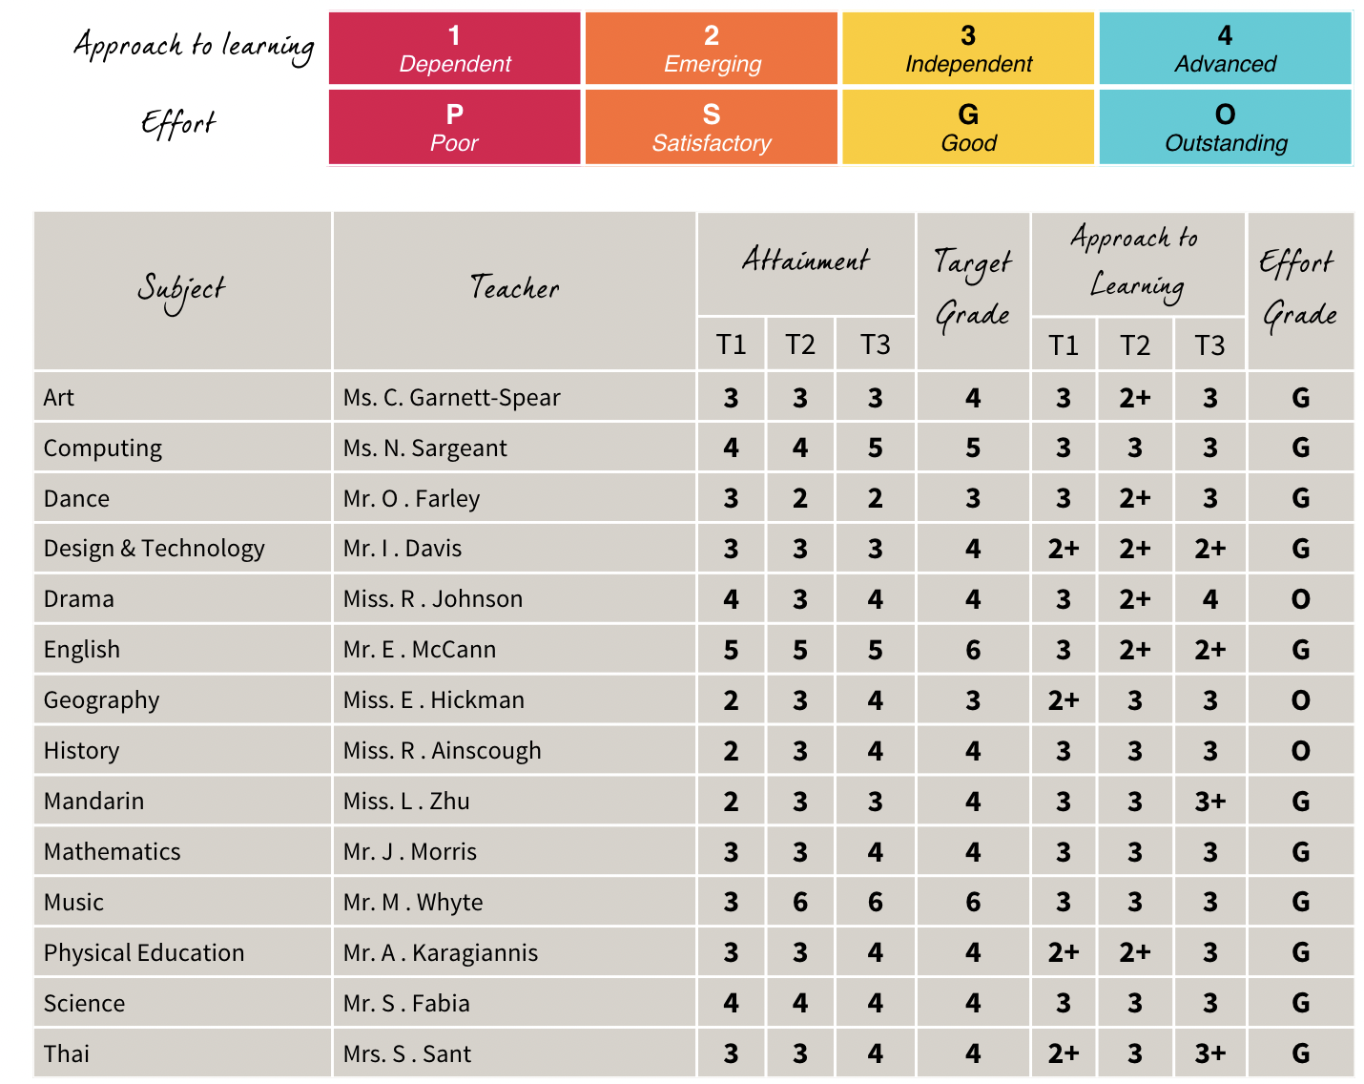
Key Stage 3 reports
3 reports per year: November, April, June
2 Parents Evenings per year: end of T1 and beginning of T3
Data: Attainment Level; Target Level; Approach to Learning; Effort
Tutor Comment
Assessment & Reports: Secondary

Slide 4
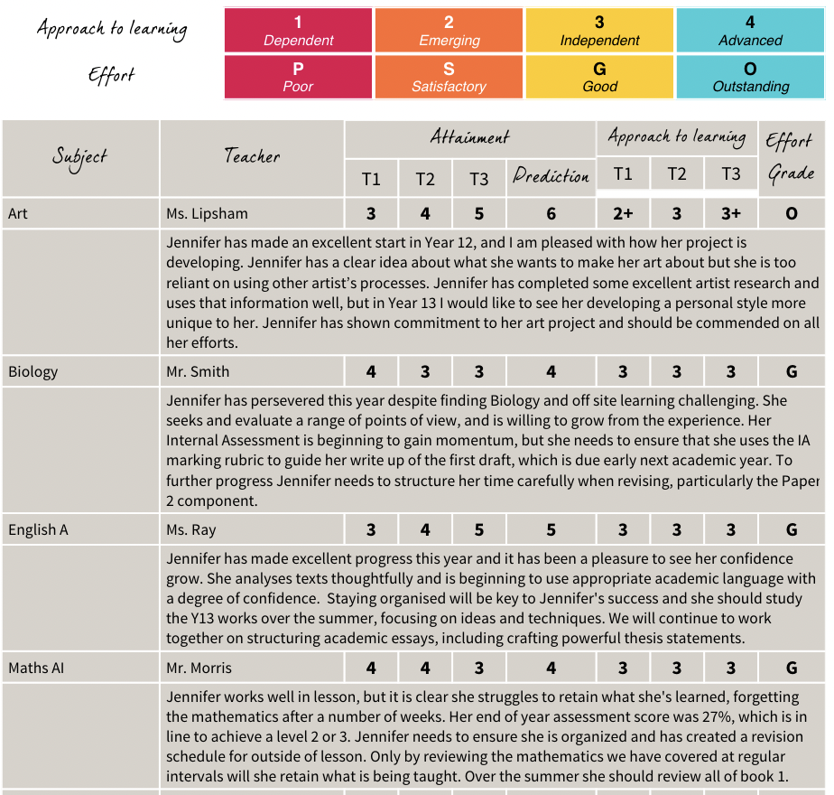
Key Stage 4 & 5 reports
3 reports per year: November, April, June
2 Parents Evenings per year: end of T1 and T2 February / March
Data: Attainment Level; Prediction; Approach to Learning; Effort
Tutor Comment
Subject Comments: T2 (Y11 & Y13)
T3 (Y10 & Y12)
Assessment & Reports: Secondary

Slide 5
What do the reports tell you? Attainment Target / prediction approach to learning effort

Slide 6
Secondary school curricula & Assessment
Years 7, 8 and 9
Key Stage 3
1 to 9
Years 10 and 11
(I)GCSE
1 to 9 & A* to G
Years 12 and 13
IB Diploma &
A Level
1 to 7 & A* to E

Slide 7
Key stage 3 attainment
Adopted a 1 to 9 scale (9 = the highest)
Students complete assessments and are levelled against criteria for each subject
Different forms of assessment are used
Use evidence from the start of the year to the point of reporting
Same criteria will be used across the 3 years
Criteria created by working back from the skills needed at IB and IGCSE in each subject area

Slide 8
Forms of assessment at Key stage 3
End of unit assessments: exam conditions
Practical work: observations
Presentations
Projects
Coursework: where a draft is marked and then a final draft produced
Controlled conditions: notes are allowed, but work produced with a time limit and under exam conditions
End of year assessment: exam conditions (Years 7 and 8 in-class; Year 9 in the gym)

Slide 9
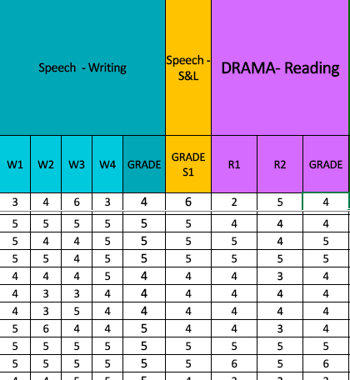
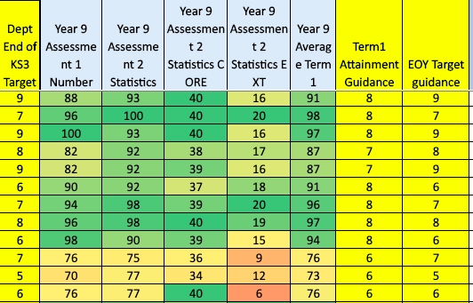
Arriving at a Key Stage 3 attainment grades
Maths Year 9 Term 1
English Year 8 Term 1
Assessment & Reports: Secondary
Notes:
Weightings may vary depending on the nature of the task. Eg speech is weighted less than a piece of writing.
Each subject collates the assessment data over the term / year to inform the report grade.
From start of the year to the point of reporting.

Slide 10
Advantages of this approach
Assessment level shared with students
Adapted criteria shared with the students
Gives a clear idea of what they have achieved
Gives a clear idea of next steps
Clearer for parents
Sense of progression over Years 7, 8 and 9
Skills, knowledge and understanding feeds directly into IGCSE and IB Diploma
Notes:
Based on needs of the students rather than age of the students.
Supports those who are new to English and supports those who need to be challenged.

Slide 11
Key stage 4 & 5 attainment
(I)GCSE grades 9 to 1 or A* to G
IB levels 7 to 1
A Levels A* to E
We use evidence from the start of the course to the point of reporting
Weightings of particular tasks
Coursework, exam practice, classwork and homework, practicals
‘Best fit’
Attainment grade on report is based on achievement to date
Mark schemes & grade boundaries provided by examining body
Notes:
More complex – each course has different requirements. The teachers know these requirements. Different mark schemes and different weightings for different tasks.
Formative / summative. Issues with tests on one topic versus tests on the topics studied in the last 3 months. More likely to do better on the latter.

Slide 12
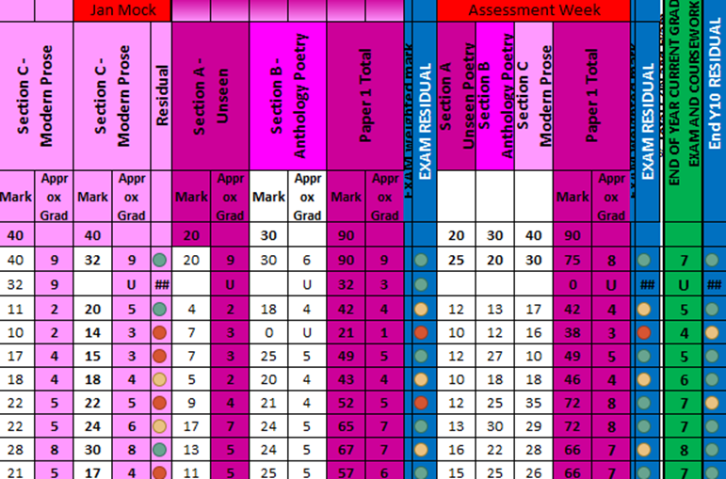
Arriving at a Key Stage 4 & 5 attainment grades
ICT Y10 T3
English Y10 T3
Assessment & Reports: Secondary
Notes:
Tracking sheets by faculty – for IG & IB
Also central tracking sheets for IG & IB to monitor students and centralise intervention work.
Build in weightings of particular pieces of work over others
Try to make this information as accurate as possible and evidence-based

Slide 13
What do the reports tell you? Attainment Target / prediction approach to learning effort

Slide 14
Target setting at Ks3
Aspirational end of year target for each subject
What the teacher thinks the student should be aiming to achieve by the end of the year
Could be adjusted over the year
Baseline test (CAT4) is used to help generate this target level
Primarily, CAT4 is what we use to judge our performance as teachers and as a school

Slide 15
Predictions at KS4 & KS5
Realistic prediction not aspirational like a target
What the teacher thinks the student will be able to achieve by the end of the 2 year course based on current performance
Can be adjusted every term
Fluctuates: skills, knowledge, topics, tasks
Application differs from subject to subject: content covered, portfolio development, course structure
Takes into account coursework and exam practice
Notes:
Important for Y12/13 – university applications
Gives parents/students information to inform future plans
Gives teachers information about where things are going right / wrong
Also use CEM and CAT4 for these year groups as benchmarks.

Slide 16
What do the reports tell you? Attainment Target / prediction approach to learning effort

Slide 17
Approach to learning
What are we trying to capture here?
What is the difficulty with this measure?
Added in ‘Effort’:
Outstanding
Good
Satisfactory
Poor
Notes:
Copy on tables….
Explain how it was conceived: all teachers in the secondary school identified what they were aiming a Regents student to be like when they left school at 18.
What learner attributes did we want them to be able to deploy?
What approach did we want them to have towards learning?
We then worked backwards and considered the steps needed to arrive at this point. These were distilled down into four areas.
Issues: ‘best fit’; level 4 is implying learning independently without being asked outside lessons.
Self-evaluating their work. Becoming less teacher reliant as they work through the levels.
Can younger students get a 4? Issue with starting new subjects in secondary eg: DT – where all are emerging – lots of support required.

Slide 18
How do the reports help you to help your child?
Notes:
Could discuss ways to support a 1 or 2 AtL child or a 3/4 AtL child…..? Or jump straight to the next slide.

Slide 19
Developing independence
Support organisation of time for homework: work towards setting their own schedules
Demonstrate how to breakdown tasks to get them done
Ask them open questions about their work
Provide a quiet place to complete homework
Discuss plans for their future
Support regular reading around areas of interest and reading for enjoyment
Limit device-time
Encourage independence and personal responsibility as part of daily routines
Notes:
Approach to learning is key.

Slide 20
Independent to advanced learner
Support reading around subjects in their own time
Support goal setting, by defining smaller achievements along the way
Redraft work, or sections of work
Take own notes, or add to notes on a topic, independently
Engage with knowledge and information about the world: read the news; scientific journals and magazines
Support reading of enjoyment
Look out for signs your child might be putting too much pressure on themselves
Ensure breaks to exercise and relax with friends
Encourage a balanced range of activities

Slide 21
Thank you…

